Slide 1
NRP
Dr. Mehrdad Rezaei
SUMS - 1399

Slide 2
Asphyxiated neonate

Slide 3
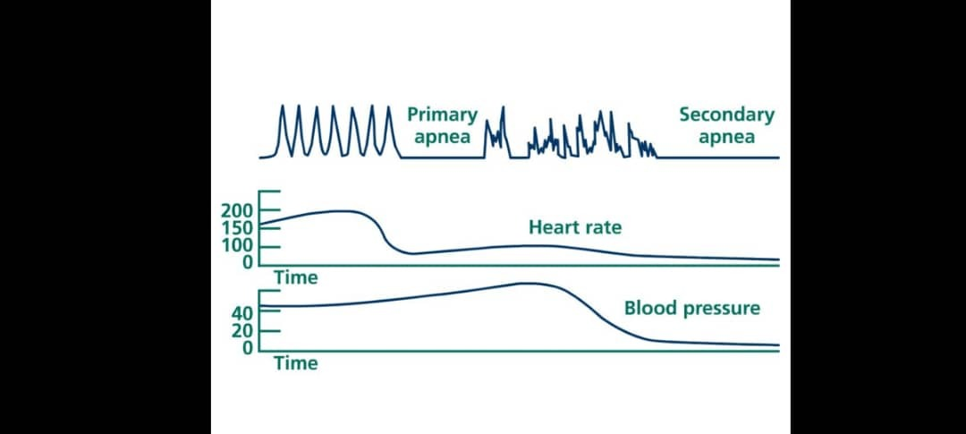

Slide 4
After birth

Slide 14
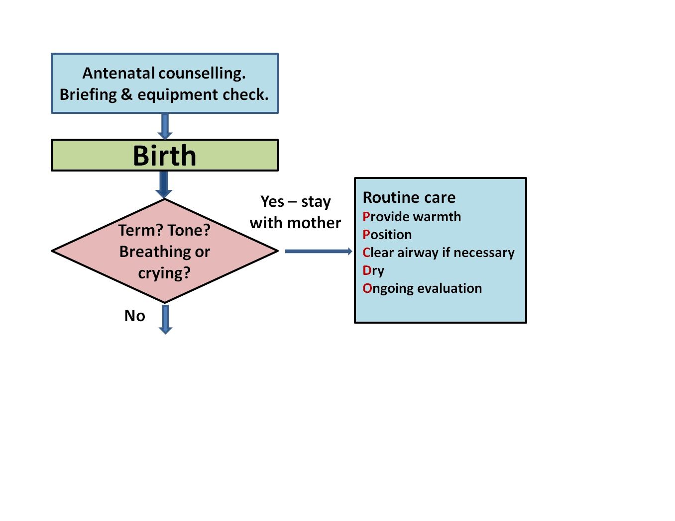

Slide 15
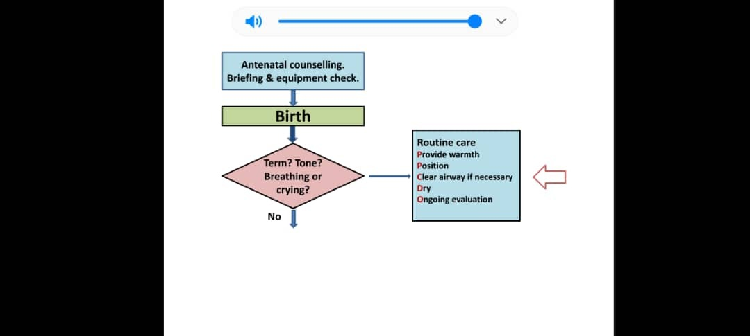

Slide 19
First Steps of neonatal resuscitaion:

Slide 34
Pulse oximetry

Slide 35
Pulse oximetry

Slide 36
Cyanosis

Slide 37
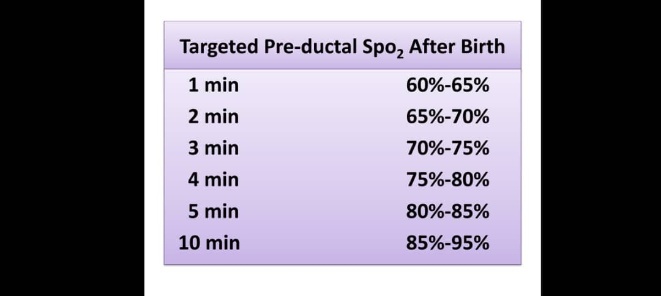

Slide 44
PPV Devices:

Slide 60
Shape

Slide 69
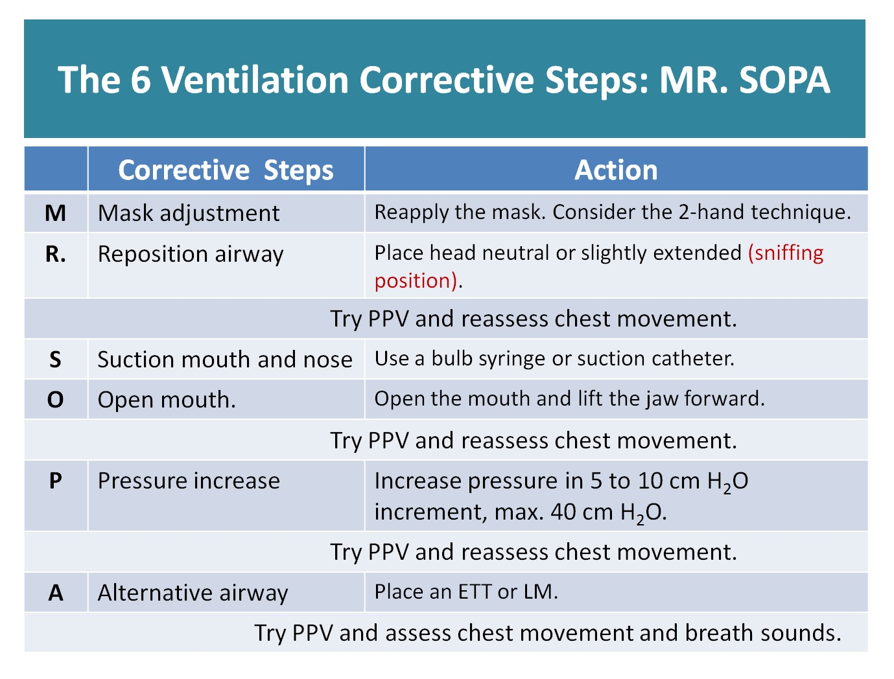

Slide 74
ETT

Slide 94
Medication:

