Slide 1
بسم الله الرحمن الرحیم

Slide 2
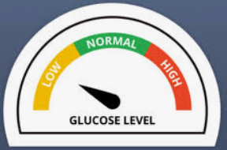
NEONATAL HYPOGLYCEMIA
“Dr. Zahra Hashemi”
Assistant professor of Neonatal- Perinatal Medicin
Neonatal research center
SUMS

Slide 3
Placental Transport of Glucose
Fetal Glucose Metabolism
Glucose Metabolism After Birth
Causes of Neonatal Hypoglycemia
Management of Neonatal Hypoglycemia
Prognosis of Neonatal Hypoglycemia

Slide 4
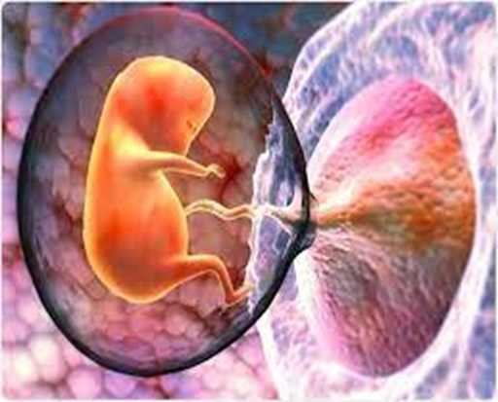
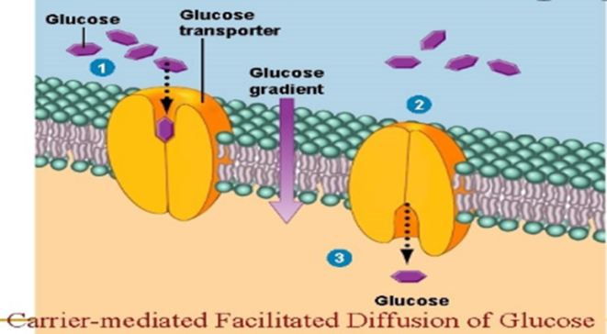
Placental Transport of Glucose
Glucose is transported to the fetus along a downward concentration gradient via facilitated transport mediated by glucose transporters (GLUTs)
the plasma glucose concentration of the fetus is about 70%-80% of that of the mother
Fluctuations in maternal blood glucose are rapidly reflected in parallel changes in fetal glucose concentration

Slide 5
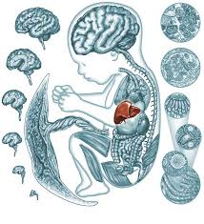
Fetal Glucose Metabolism
Hepatic glycogen content is low early in gestation.
A slow, continuous increase occurs between 15 and 20 weeks.
A rapid accumulation of glycogen in the liver is observed after 20 wks.

Slide 6
Placental Transport of Glucose
When fetal glucose uptake
exceeds the requirements of
energy production and growth,
the excess glucose is stored as
glycogen and triglycerides.
Glucose: 80% of fetal energy consumption
lactate, amino acids, and other means: The remaining 20% of fetal energy needs.

Slide 7
Glucose Metabolism After Birth
At birth, after separation from the umbilical circulation, the supply of glucose and other nutrients abruptly ceases, and the newborn infant has to mobilize its depots to meet energy requirements

Slide 8
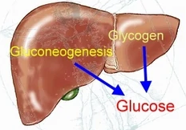
Glucose Metabolism After Birth
clamping of the umbilical cord
Acute surge in the levels of circulating
epinephrine, norepinephrine, glucagon, cortisol, GH
fall in the levels of insulin
Glycogenolysis
Gluconeogenesis
glucose production and maintenance of the plasma glucose concentration

Slide 9
lowest value of the plasma glucose concentration 30 and 90 minutes after birth.
The brain is an obligatory consumer of glucose (consuming 80% of total glucose produced).
The availability and use of alternative energy sources (i.e., ketones and lactate) may explain the apparent tolerance of lower plasma glucose concentrations by the neonate.

Slide 10
After 4-6 hours post feeding state, steady state plasma glucose concentration is maintained with interactions between insulin and counter regulatory hormones.

Slide 11
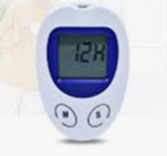
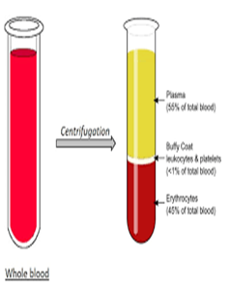
Factors frequently overlooked in the interpretation of glucose concentration are the type of sample and The method of analysis.
Test strip methods VS laboratory methods
Whole blood VS Plasma

Slide 12
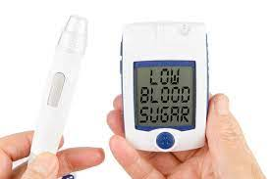
test strip methods laboratory methods
There are variations in glucose concentrations in test strip methods particularly in the low glucose range (<45 mg/dL).
Borderline values (<40-45 mg/dL) should be repeated by using standard laboratory methods

Slide 13
Whole blood VS Plasma
glucose concentration:
Plasma ˃ Whole blood (about 14%)
RBC contain high concentrations of glycolytic intermediates
In vitro glycolysis is increased in RBC at room temperature.
Whole-blood glucose values may drop 15-20 mg/dL per hour if the sample is allowed to stand at room temperature

Slide 15
Infants at risk for hypoglycemia
Preterm infants (GA ˂ 37 weeks)
Infants who are LGA
Infants with IUGR ; SGA
Infants of diabetic mothers
Infants who require intensive care
Congenital syndromes
Infants whose mothers were treated with some agents
Family history of a genetic form of hypoglycemia
Infants who have experienced perinatal stress due to:
Birth asphyxia
Maternal preeclampsia/eclampsia or hypertension
Meconium aspiration syndrome
Erythroblastosis fetalis
Polycythemia
Postmature infants

Slide 16
Clinical Symptoms and Signs of Hypoglycemia
Abnormal crying
Irritability
Apnea, cyanotic spells
Jitteriness, tremors
Feeding difficulty
Lethargy or stupor
Grunting, tachypnea
Tachycardia
Hypothermia
Seizures
Sweating
Hypotonia

Slide 17
transient or persistent hypoglycemia
Transient hypoglycemia is often a consequence of changes in the metabolic environment in utero or exutero.
Persistent or recurrent hypoglycemia arises from intrinsic metabolic problems in the infant.

Slide 18
Associated with neonatal problems:
Failure to adapt
IUGR
Prematurity
Birth asphyxia
Infection
Hypothermia
Polycytemia and Hyperviscosity
Erythroblastosis fetalis
Iatrogenic causes
Congenital cardiac malformations
TRANSIENT HYPOGLYCEMIA
Associated with changes in maternal metabolism:
Intrapartum administration of glucose
Drug treatment
Infant of diabetic mother
Maternal Obesity

Slide 19
TRANSIENT HYPOGLYCEMIA Associated with changes in maternal metabolism
1- Intrapartum Glucose Administration:
increased glucose, insulin, and lactate levels in the cord blood
Fetal hyperinsulinism
hyperinsulinemia and hypoglycemia in the neonate

Slide 20
TRANSIENT HYPOGLYCEMIA Associated with changes in maternal metabolism
2- Maternal Pharmacologic Treatment :
Oral antihyperglycemic drugs:
(metformin, Glyburide, tolbutamide)
Benzothiadiazide diuretics
Oral beta-sympathomimetic tocolytic drugs:
(terbutaline , ritodrine)
Beta-adrenergic blocking agents:
(propranolol)

Slide 21
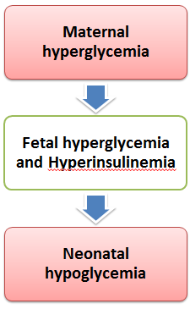
TRANSIENT HYPOGLYCEMIA Associated with changes in maternal metabolism
3- Infant of diabetic mother

Slide 22
TRANSIENT HYPOGLYCEMIA Associated with changes in maternal metabolism
4- Maternal Obesity
The exact mechanism of impaired glucose homeostasis in these infants is not clear yet but may :
maternal insulin resistance
redirecting glucose from maternal tissues to the fetus

Slide 23
TRANSIENT HYPOGLYCEMIA Associated with neonatal problems
1-Failure to adapt
For unknown reasons, a number of infants develop hypoglycemia, designated as idiopathic hypoglycemia or failure to adapt to the extrauterine environment.
Contributory factors may include maternal obesity and mild glucose intolerance in the mother.

Slide 24
TRANSIENT HYPOGLYCEMIA Associated with neonatal problems 2- IUGR
Decrease in glycogen stores
Decrease in adipose tissue
Decrease in gluconeogenesis
Increased sensitivity to insulin
polycythemia and fetal and neonatal hypoxemia are frequently seen in infants who are SGA,
large head and brain size with a large proportion of total glucose utilization

Slide 25
TRANSIENT HYPOGLYCEMIA Associated with neonatal problems
3- Prematurity
Diminished glycogen reserves (Because glycogen is deposited during the third trimester of pregnancy)
Low activity of glucose- 6-phosphatase (It catalyzes the breakdown of glucose-6-phosphate into free glucose, the terminal step in both glycogenolysis and gluconeogenesis)

Slide 26
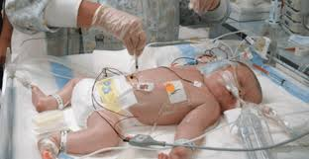
TRANSIENT HYPOGLYCEMIA Associated with neonatal problems
4- Birth asphyxia
An increased insulin concentration
Increased sensitivity to insulin
Increased glucose consumption
Increase in plasma glucagon, interleukin-6 , hydrocortisone, and other counter-regulatory hormones

Slide 27
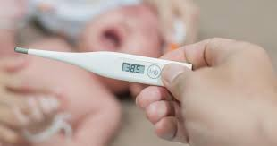
TRANSIENT HYPOGLYCEMIA Associated with neonatal problems
5- Infection
Hyperglycemia is more common than hypoglycemia (as a result of counter-regulatory hormonal responses)
A decrease in these processes is seen only during a fulminate infection

Slide 28
TRANSIENT HYPOGLYCEMIA Associated with neonatal problems
6- Hypothermia
Hypoglycemia, may affect a thermoregulatory center in the hypothalamus that is sensitive to glucose; so hypothermia secondary to hypoglycemia has been well documented
prolonged exposure to cold (T ≤ 32°C)
Hypoglycemia due to diminished availability of glucose and increased rates of glucose utilization

Slide 29
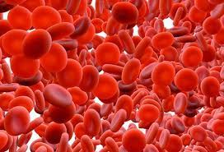
TRANSIENT HYPOGLYCEMIA Associated with neonatal problems 7- Hematologic Disorders
polycythemia
erythroblastosis fetalis
Hypoglycemia associated with polycythemia may result from greater glucose utilization by the increased mass of RBC
Erythroblastosis at birth is associated with an increased number of NRBC ,in the peripheral blood of newborns, an indicator of fetal hypoxia

Slide 30
TRANSIENT HYPOGLYCEMIA Associated with neonatal problems
8- Iatrogenic Causes
Aafter abrupt cessation of hypertonic glucose infusions, (including those used for parenteral nutrition)
Umbilical artery catheter positioned near the origin of the vessels supplying the pancreas (T11 to L1).

Slide 31
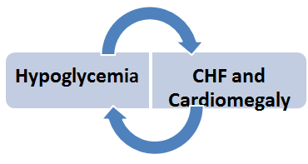
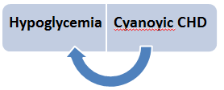
TRANSIENT HYPOGLYCEMIA Associated with neonatal problems
9- Cardiac disease
Although the mechanism is unknown, chronic hypoxia, leading to decreased glycogen stores, may be a contributing factor

Slide 32
Persistent Hypoglycemia
1-Hyper
insulinism
2-Endocrine disorders
3-Inborn errors of metabolism

Slide 33
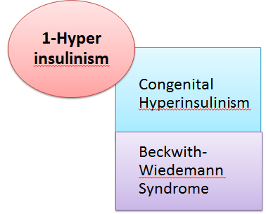
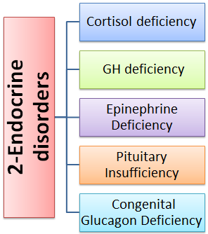
hypoglycemia

Slide 34
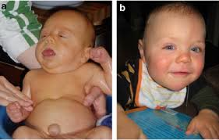
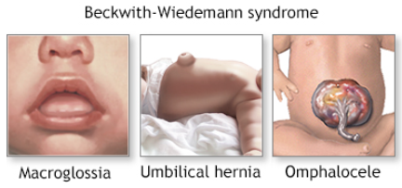
Beckwith-Wiedemann syndrome (BWS)
Hemihypertrophy,
Muscular hypertrophy
macroglossia,
Abdominal wall defects:
(omphalocele, Umbilical hernia )
Cardiac defects
Clitoromegaly
Cryptorchidism

Slide 35
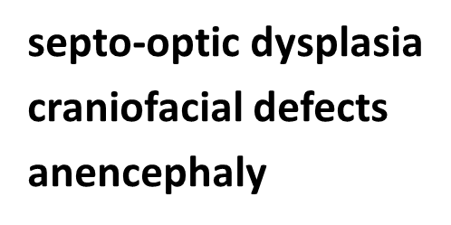
Pituitary Insufficiency

Slide 36
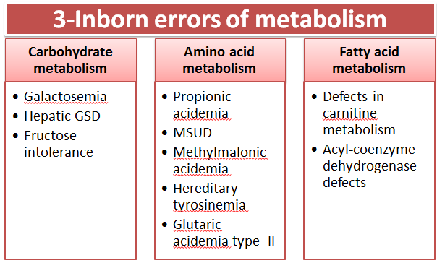

Slide 37
*Neuroglycopenia (hypoglycorrhachia)
Glucose Transporter Type 1 Deficiency Syndrome
Serum glucose 86-120 mg/dl.
Low glucose (18 – 35mg/dl) and lactate in the CSF.
Diagnostic testing includes:
A fasting LP ,documenting hypoglycorrhachia
Genetic sequencing for the GLUT1 gene at chromosome 1p34.

Slide 38
Management of Neonatal Hypoglycemia

Slide 39
of management
To correct blood glucose levels in symptomatic patients
To prevent symptomatic hypoglycemia in at-risk patients
To avoid unnecessary treatment of infants with transitional low blood glucose, which will self-resolve without intervention
To identify newborns with a serious underlying hypoglycemic disorder

Slide 40
Of hypoglycemia
Infants at risk for hypoglycemia ?
symptomatic or asymptomatic ?
transient or persistent ?

Slide 41
The definition of hypoglycemia for preterm infants should not be any different from that for full-term infants.
The presence or absence of clinical signs cannot be used reliably to define neonatal hypoglycemia
Most newborns remain asymptomatic despite very low blood glucose concentrations, some newborns become symptomatic at the same or even higher blood glucose concentrations than are observed in asymptomatic infants.

Slide 42
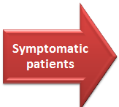

Slide 44
Guidelines published by the AAP and the PES
Treatment of neonatal hypoglycemia is a stepwise process depending on:
The presence or absence of symptoms and signs
and
the response of the infant at each step.

Slide 45
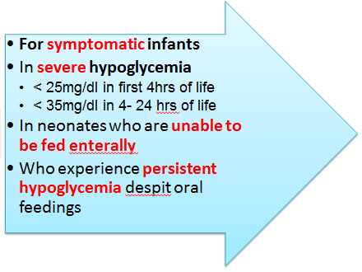
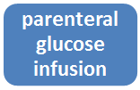
Treatment of neonatal hypoglycemia

Slide 46
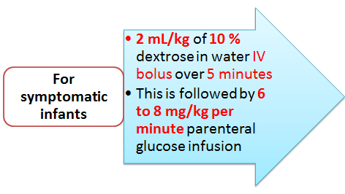
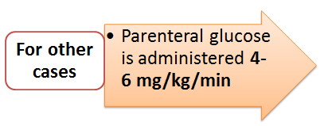

Slide 47
Aasymptomatic infants at risk for hypoglycemia
Initial oral feeding should be given within the first hour of life in delivery room.
BS should be measured frequently, starting 20 to 30 minutes after the initial feed and then before subsequent feedings.

Slide 48
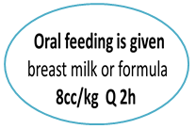
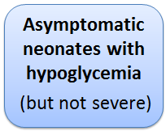

Slide 49
For asymptomatic at-risk infants with hypoglycemia , buccal dextrose gel 40% is emerging as an effective and safe therapy when used in conjunction with breast milk , prior to feeding .
The routine use of prophylactic dextrose gel is not recommended.
dextrose gel 40% :
200 mg/kg = 0/5 cc/kg

Slide 50
For preterm infants GA < 35 weeks
who are able to maintain adequate nutrition by enteral feeds
those who are not expected to be able to receive enough enteral nutrition due to prematurity
parenteral nutrition, which includes glucose, should be started quickly

Slide 51
Transition from IV to oral feeds
When the glucose concentration is stabilized and maintained at or above the threshold value, the glucose infusion rate can be tapered slowly as feedings are advanced .
While the IV glucose infusion is tapered, the blood glucose level should be monitored before each feed.
The taper typically occurs over a period of two to four days

Slide 52
If the glucose concentrations do not increase to normal levels with 4-6 mg/ kg/ min , the rate of infusion should be increased by 1-2 mg/kg per minute every 3-4 hours while monitoring the glucose response.
Infants who require high rates of glucose infusion (dextrose concentrations ˃ 12.5 % )may benefit from having a central line or an umbilical vein catheter placed above the liver.

Slide 53
Infants who are not able to maintain preprandial plasma glucose >60 mg/dL after 48 hours of age without IV dextrose
Infants who have severe hypoglycemia requiring prolonged and/or high rates of IV dextrose infusion(≥ 12 mg/kg/min )
The evaluation for a persistent hypoglycemic disorder and hyperinsulinism should be performed

Slide 54
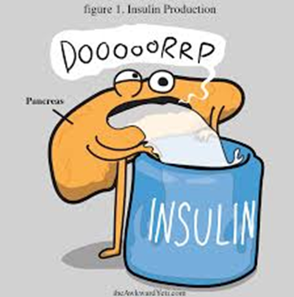
Persistent hypoglycemic disorder
"critical" blood test sampling
when the plasma glucose <50 mg/dl
Blood glucose( to confirm hypoglycemia)
Insulin
Cortisol
blood pH, bicarbonate
Lactate
C-peptide
7. free fatty acids
8. Growth hormone
9. beta-hydroxybutyrate
10. Metabolic pannel (acylcarnitine profile , plasma free and total carnitine levels , serum amino acids, urine organic acids)
11. specific genetic tests

Slide 55
Hyperinsulinemic hypoglycemia is also seen in an asymptomatic and otherwise healthy term infant in 48 hours (to 96 hrs) of age old with normal low blood glucose levels.
A waiting period beyond the first 48 hours of life is necessary because it is difficult to distinguish newborns with a pathological hypoglycemia disorder from physiologic mild hyperinsulinism

Slide 56
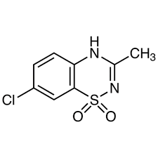
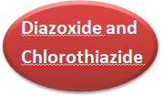
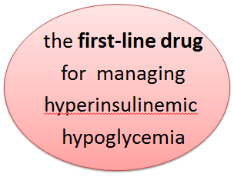
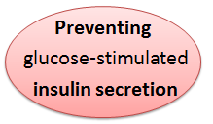
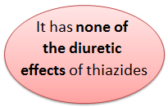
Therapeutic options in persistent hypoglycemia

Slide 57
Hypotension
Sodium and water retention and edema
Hypertrichosis
Thrombocytopenia
Anorexia
Diarrhea and vomiting
Eextrapyramidal symptoms
OF DIAZOXIDE

Slide 58
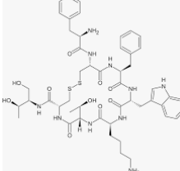
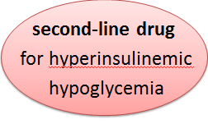
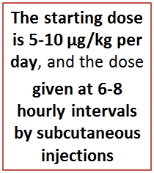
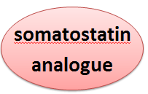
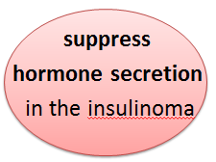

Slide 59
Inhibits the secretion of:
glucagon
insulin
growth hormone
thyrotropin.
physiologic effects on the gut :
inhibits the exocrine secretion
Changes in gut motility
Reduction of splanchnic blood flow

Slide 60
Tachyphylaxis leads to a rapid decrease in the response to octreotide 24-48 hours after treatment initiation.
Response can be assessed only 2 days after the initiation of a new dose

Slide 61
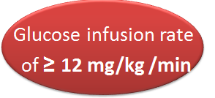
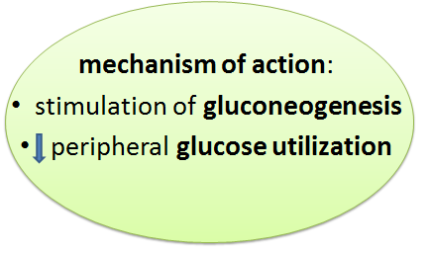

Slide 62
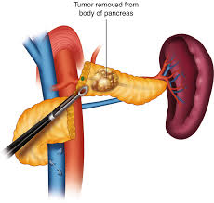
Pancreatectomy
Limited pancreatectomy :Focal form of congenital hyperinsulinism:
Near total or total pancreatectomy : Diffuse form of congenital hyperinsulinism

Slide 63
Symptomatic hypoglycemia can result in brain injury that can be detected by MRI ;
BUT , there are no available data that clearly define the glucose concentration or the duration of hypoglycemia that correlate with long-term neurologic sequelae (because of co-morbidities identified with each study.)

Slide 64
Several studies report neurodevelopmental sequelae due to repeated or prolonged asymptomatic episodes of neonatal hypoglycemia.
The long-term impairment of neurodevelopment may be greater in preterm and SGA infants with repeated hypoglycemic episodes.

Slide 65
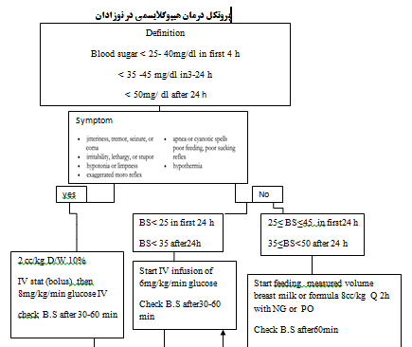
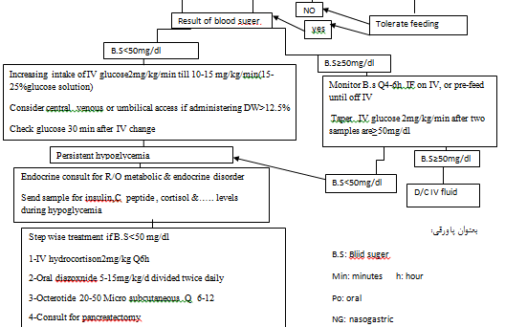

Slide 66
T
A
N
K
S

