Slide 1
In the name of God

Slide 2
Endoscopic Treatments of GERD:
Between the Pill & the Knife
Iraj Shahramian
Professor of Pediatric Gastroenterology and Hepatology- ERCP/EUS Fellowship
Shiraz University of Medical Sciences
May 2025

Slide 3


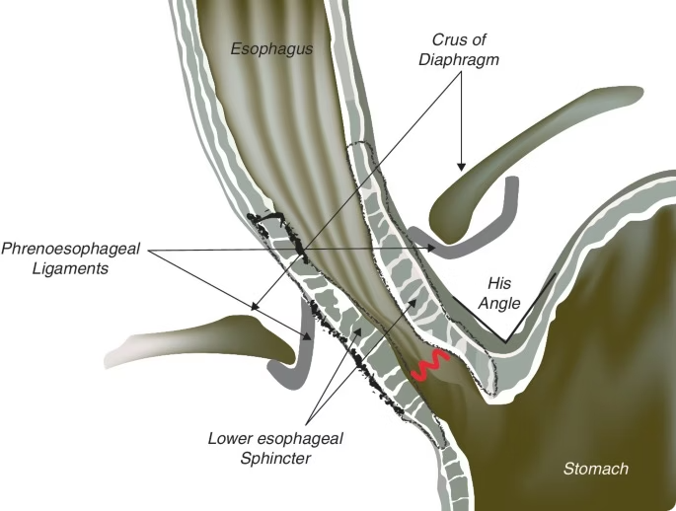


Anti-Reflux Barriers
Lower Esophageal Sphincter (LES)
Crural Diaphragm
Phrenoesophageal Ligament
GERD occurs when these natural anti-reflux barriers fail to function properly. The lower esophageal sphincter may have inadequate pressure, the crural diaphragm might be compromised, or the phrenoesophageal ligament could be weakened.

Slide 4
Treatments of GERD
Lifestyle Modifications
1
2
Medical Therapy
Surgical Treatment
3
4
Endoscopic Therapy

Slide 5

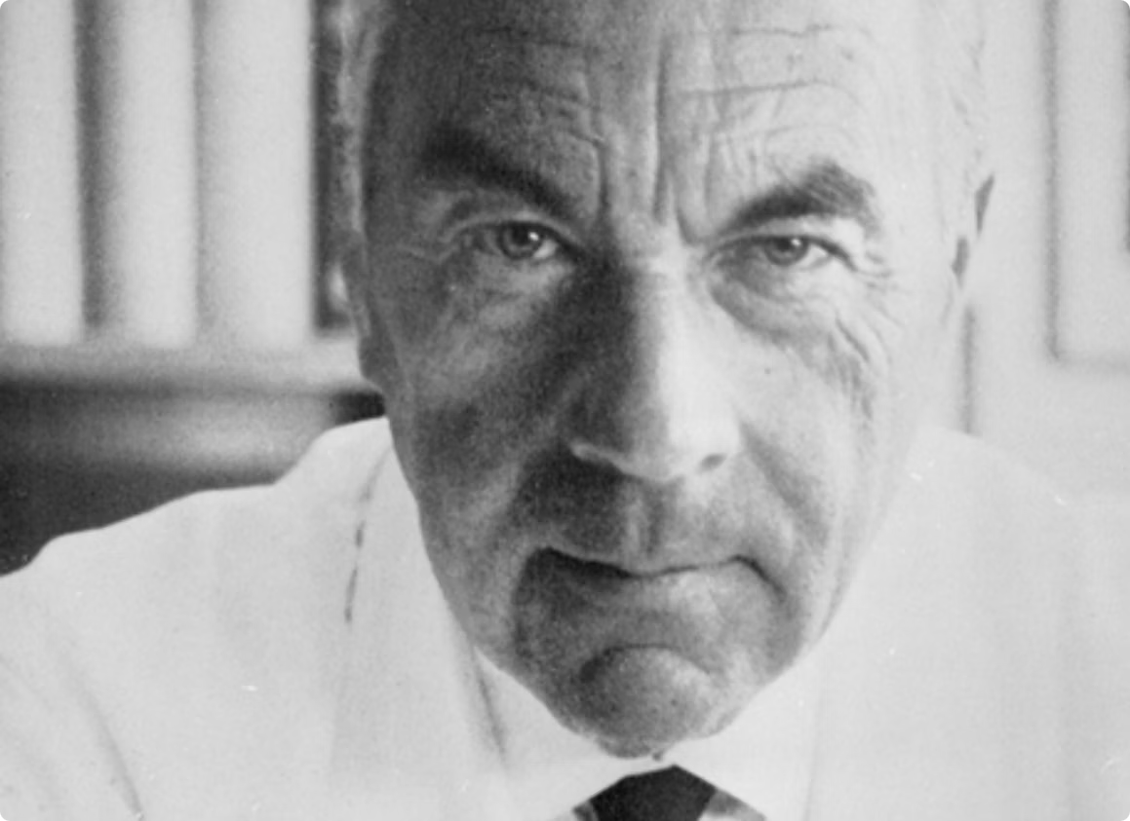
Total Fundoplication
Pioneered by German surgeon Rudolph Nissen

Slide 6

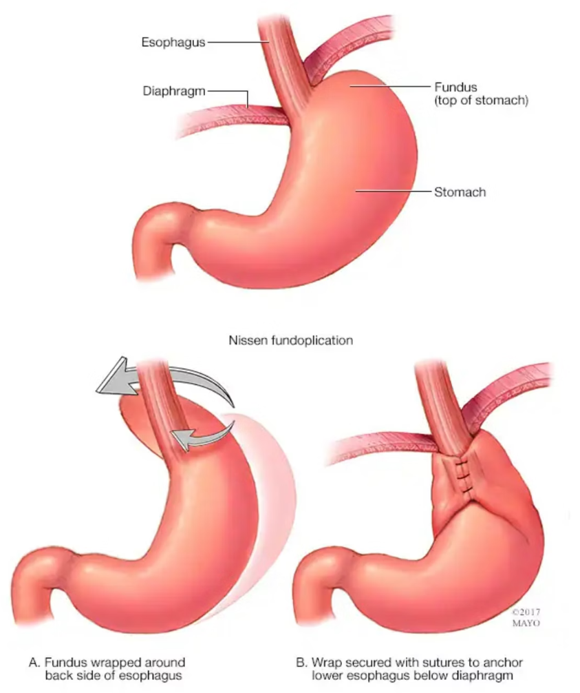
Nissen Fundoplication
Total (360 degree)

Slide 7






Surgical Management of GERD
Nissen Fundoplication
Thal
Total 360° wrap
270° anterior wrap
1
2
Toupet
Belsey
6
3
270° posterior wrap
270° anterior transthoracic
5
4
Lind
Dor
300° posterior wrap
180-200° anterior wrap
Various partial fundoplication methods have since been developed, each with specific wrapping angles and approaches.

Slide 8

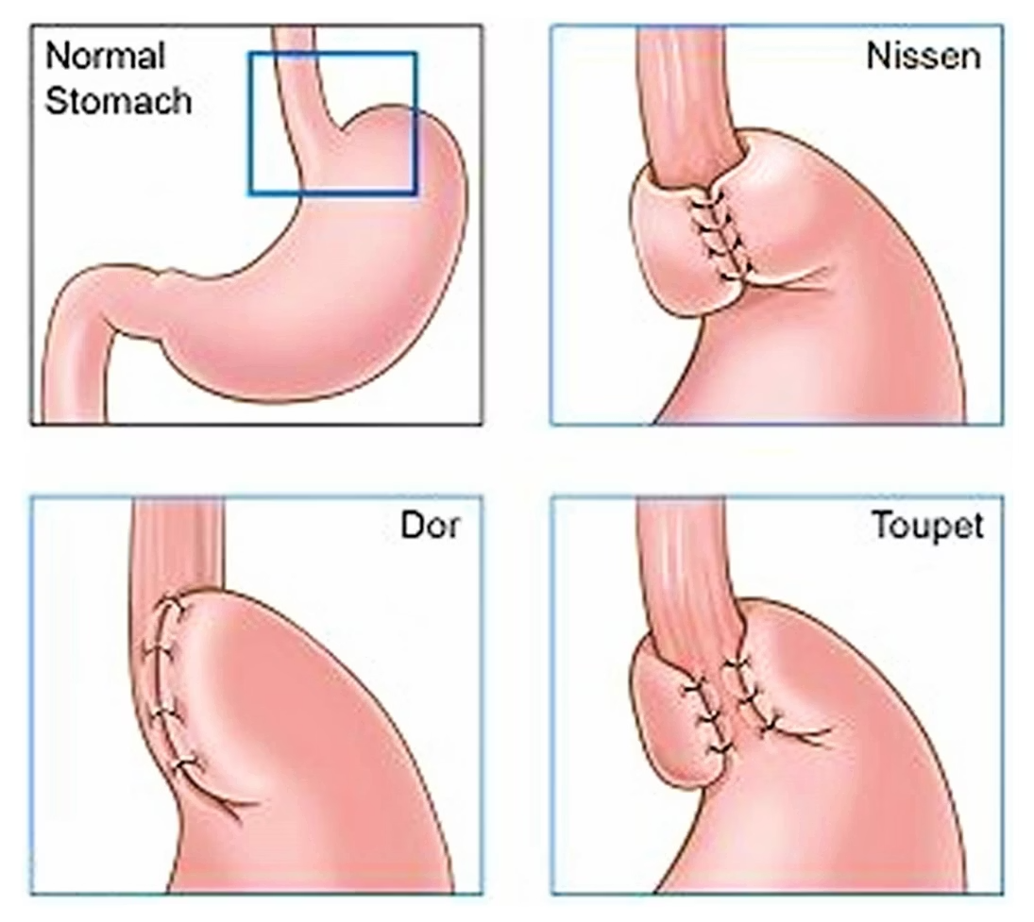
Partial Fundoplications

Slide 9

Limitations of Surgical Fundoplication
Adverse Effects
Short-Term Failure
Long-Term Medication Use
Dysphagia
Fundoplication fails in 10-15% of patients.
More than 30% of patients remain on PPIs years after surgery.
Gas bloat syndrome
Incisional hernia
Many patients require revisional surgeries

Slide 10




Indications for Endoscopic Anti-Reflux Therapy
PPI Nonresponders
PPI Contraindications
Patients with persistent or progressive symptoms despite optimal medical therapy
Patients who cannot take PPIs due to medical contraindications
Long-Term PPI Concerns
Surgery Avoidance
Patients worried about potential adverse effects of prolonged PPI use
Patients who do not qualify for surgery or refuse surgical intervention

Slide 11

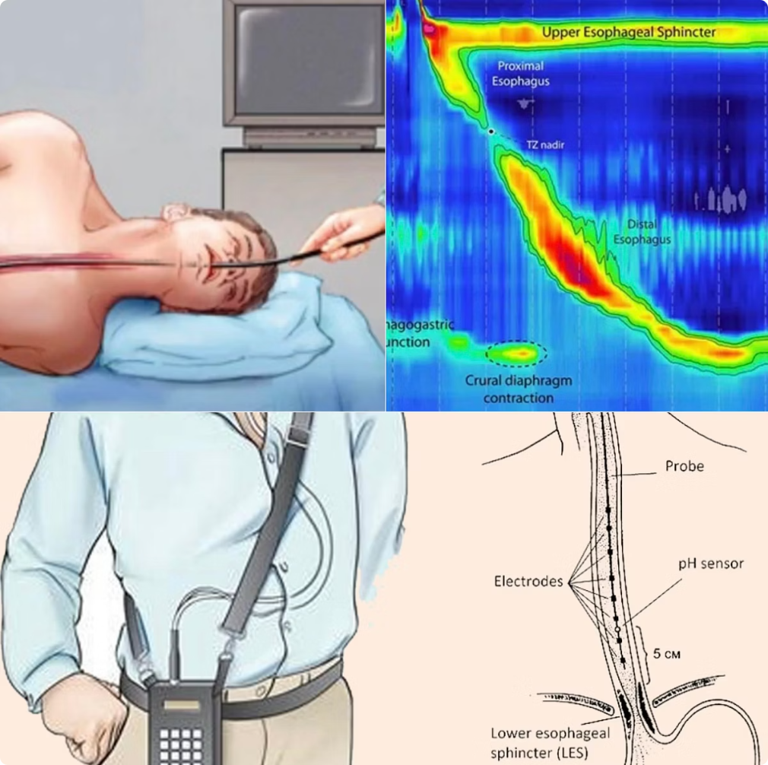



Pre-Procedure Evaluation
Endoscopy with Biopsy
Assess esophageal mucosa and rule out other conditions
High Resolution Manometry
Evaluate esophageal motility and LES function
pH/Impedance Monitoring
Confirm and quantify reflux episodes

Slide 12

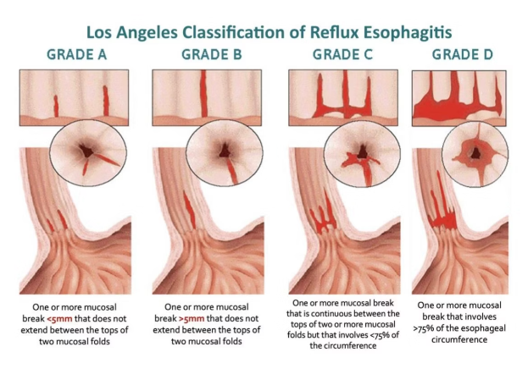
Patient Selection
Ideal candidates should not have severe esophagitis (LA grade C/D), esophageal dysmotility, or large hiatal hernias (>2cm).
The best outcomes are typically seen in patients who respond well to PPIs, suggesting that their symptoms are primarily acid-related rather than functional.

Slide 13

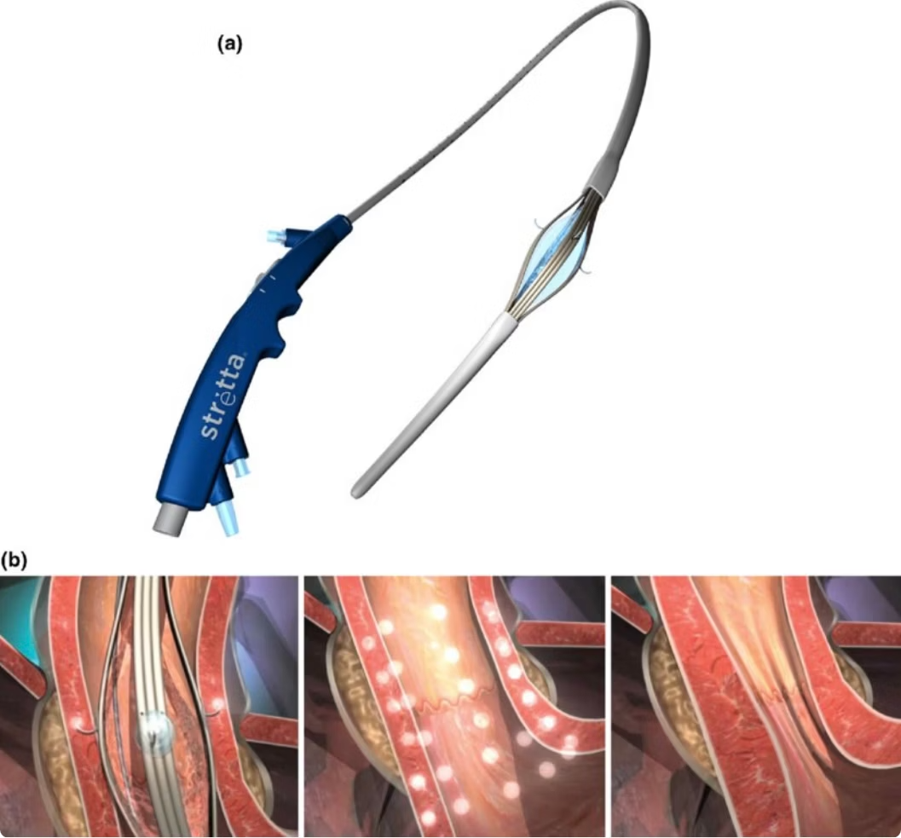
Radiofrequency Ablation
RFA (Stretta)
The Stretta procedure uses radiofrequency energy to create thermal lesions in the LES and gastric cardia. This leads to collagen deposition and remodeling, ultimately strengthening the anti-reflux barrier.

Slide 14

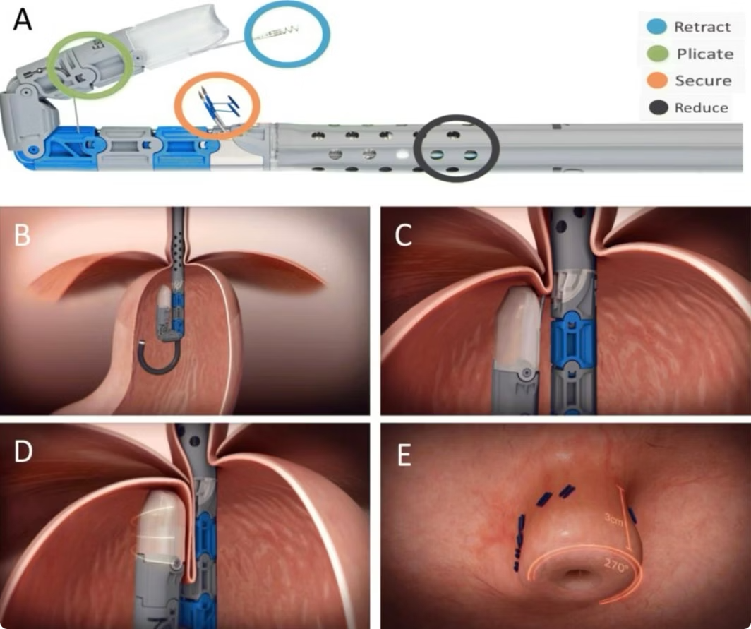
Transoral Incisionless Fundoplication (TIF)
TIF creates a valve at the gastroesophageal junction by securing tissue with fasteners, mimicking aspects of surgical fundoplication but without incisions. The procedure reconstructs the angle of His and lengthens the esophagus.

Slide 15

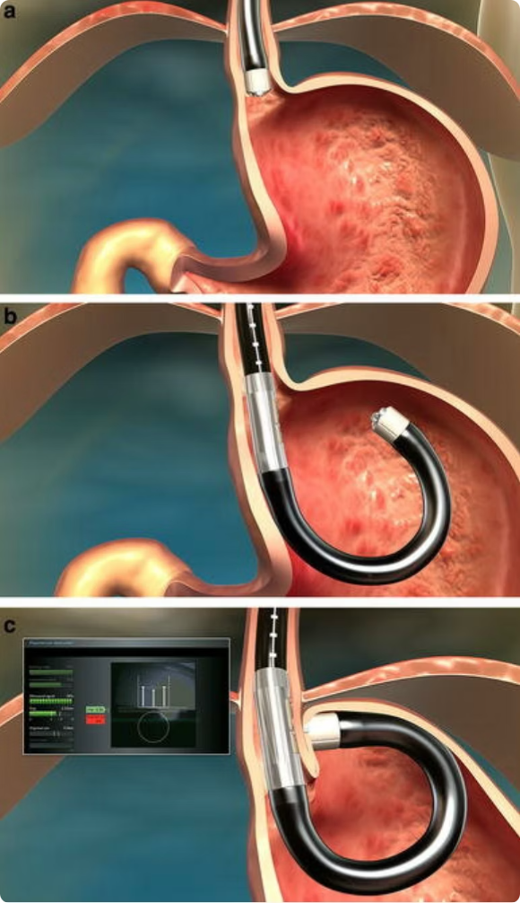
MUSE System for GERD Treatment
Device Positioning
The Medigus Ultrasonic Surgical Endostapler (MUSE) is positioned at the GEJ under ultrasonic guidance.
Tissue Capture
The device captures tissue from both the esophageal and gastric sides to create a fundoplication-like effect.
Staple Deployment
Surgical staples are deployed to secure the tissue in place, creating a durable anti-reflux barrier.

Slide 16

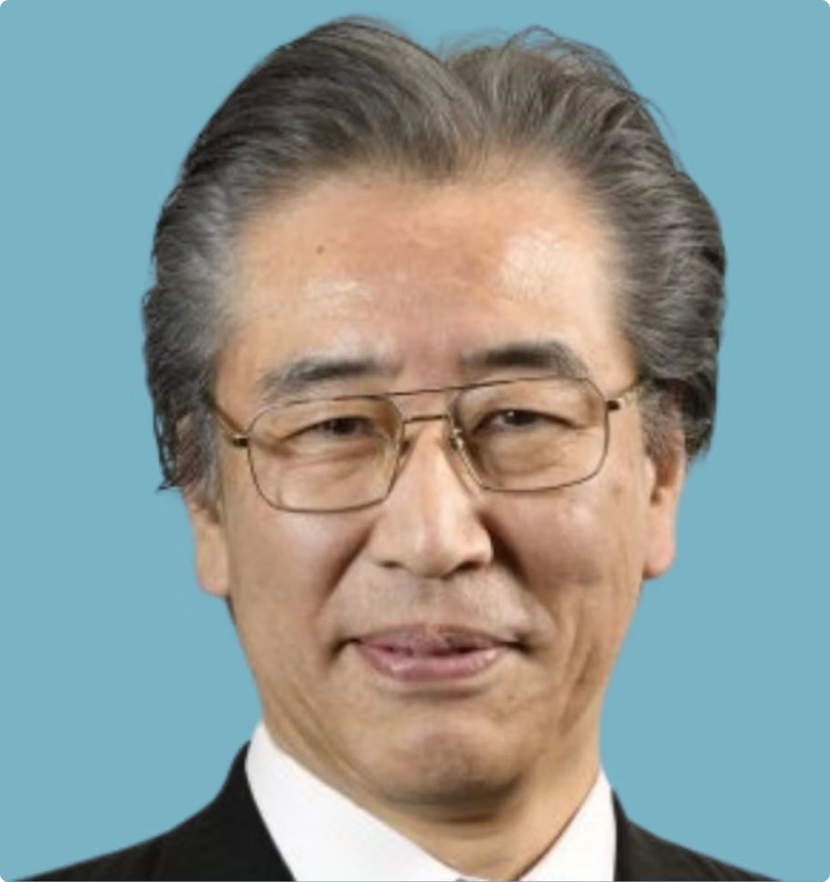



Anti-Reflux Mucosal Intervention (ARMI) Procedures
ARMS
Anti-Reflux Mucosectomy
ARMA
Anti-Reflux Mucosal Ablation
ARBL
Anti-Reflux Band Ligation
Pioneered by Japanese thoracic surgeon and endoscopist Haruhiro Inoue.

Slide 17
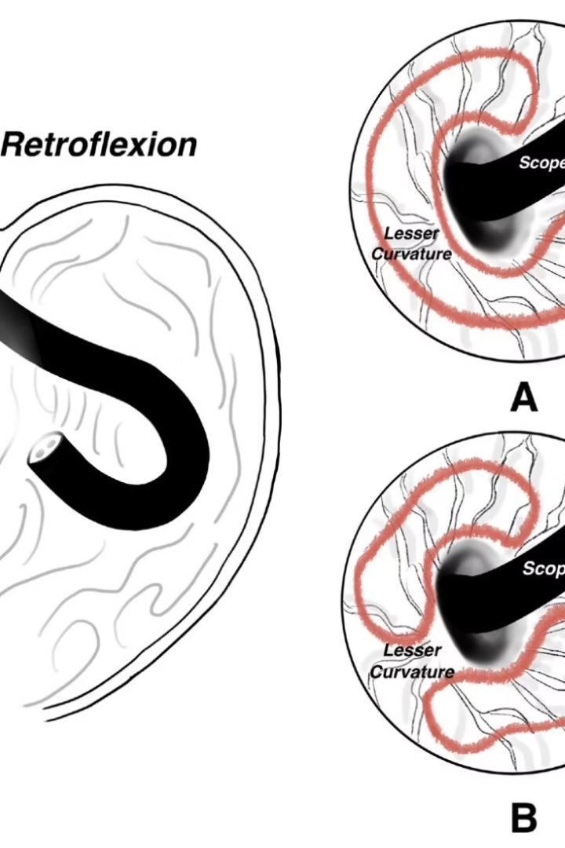
ARMS
(A) Previous ARMS technique sparing only greater curve
(B) Current ARMS technique sparing the lesser curve in addition to greater curve

Slide 18

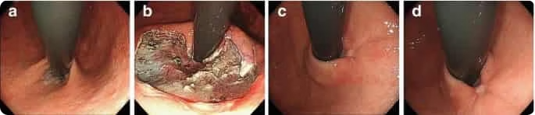
ARMS
(a) Finding before the procedure.
(b) Endoscopic mucosal resection.
(c, d) Improvement of Hill grade after procedure due to scarring.

Slide 19

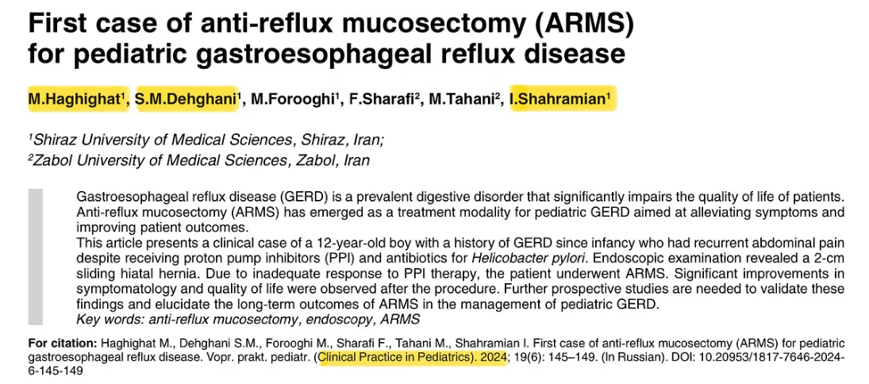
First case of ARMS in pediatric age group

Slide 20

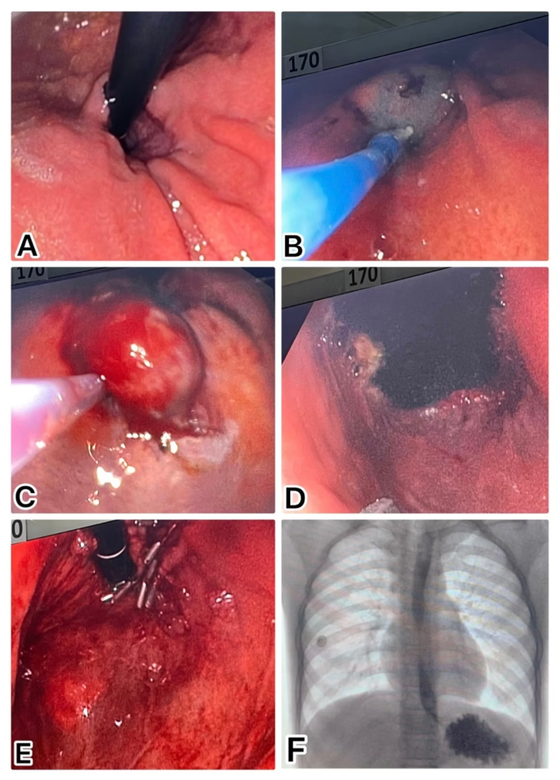
First case of Pediatric ARMS procedure in Shiraz
(A) Hiatal hernia
(B) Submucosal injection of epinephrine
(C) EMR
(D) After EMR
(E) Mucosal closure
(F) No leakage in fluoroscopic study post procedure

Slide 21

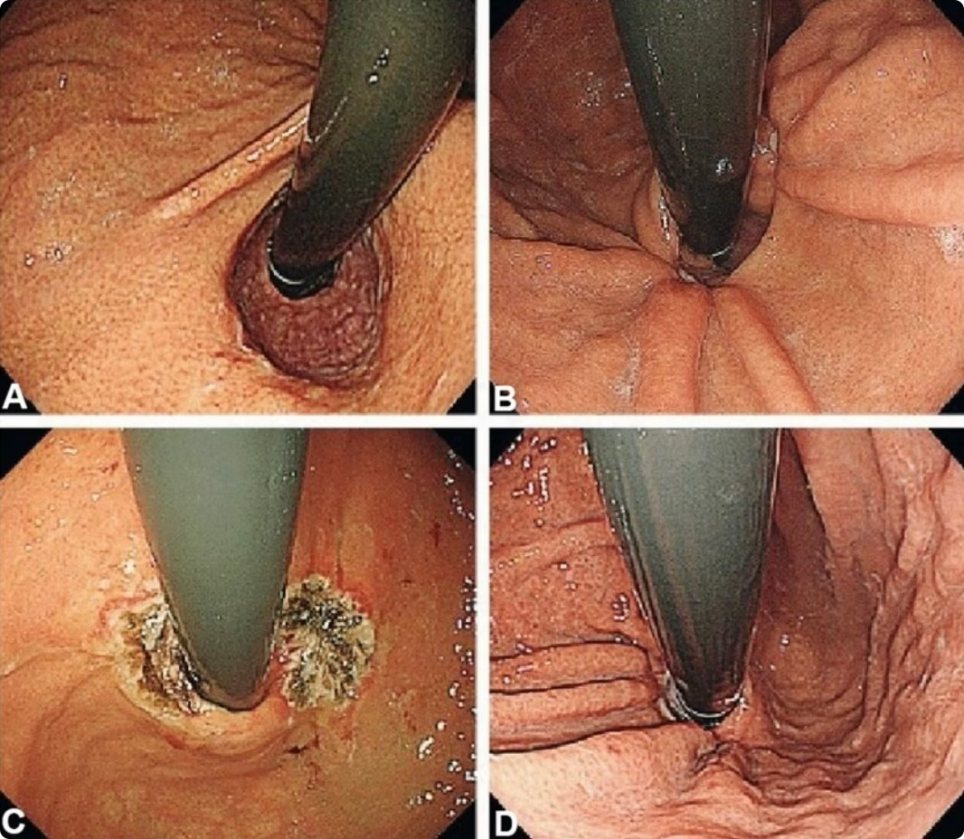
ARMA
(A) Before procedure
(B) Post ARMS
(C) Immediately after procedure
(D) 1 month post ARMA

Slide 22

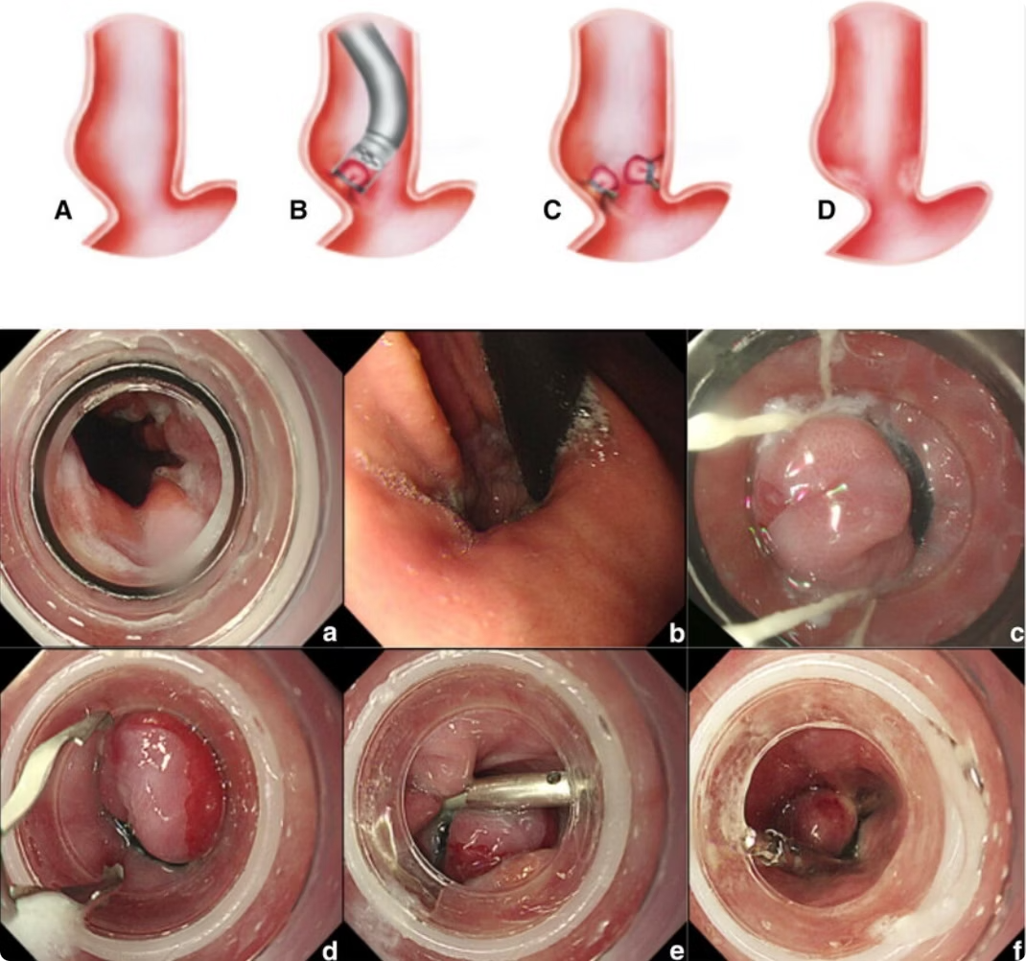
ARBL

Slide 23

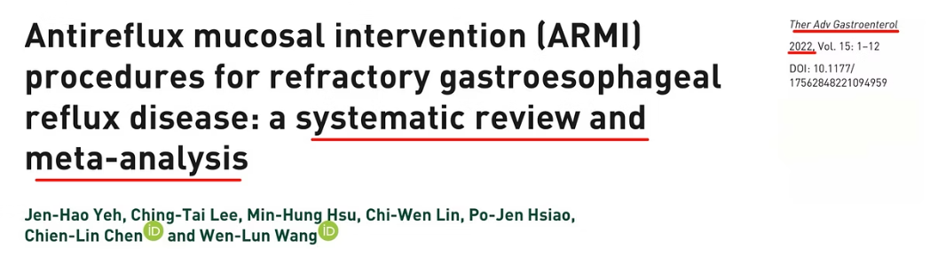
All three approaches have shown efficacy and safety for PPI-refractory GERD in clinical studies, offering minimally invasive alternatives to traditional surgery.

Slide 24
Comparing Endoscopic GERD Treatments
Procedure
Mechanism
Recovery Time
Best For
Stretta (RFA)
Thermal remodeling of LES
1-2 days
Mild GERD, no hiatal hernia
TIF
Partial fundoplication
2-7 days
Moderate GERD, small hiatal hernia
MUSE
Stapled fundoplication
2-3 days
Moderate GERD, precise targeting needed
ARMI Procedures
Mucosal modification
1-3 days
PPI-refractory GERD, Asian populations
Endoscopic treatments for GERD offer a valuable middle ground between medications and surgery. Each technique has specific advantages and ideal patient populations.

Slide 25
Take home message
Endoscopic therapies for GERD treatment are reducing the need for lifelong medication or invasive surgery for many patients.
As a GI man, we should establish our role in treatment of GERD by offering something more than life style modification & medications.

Slide 26
Thank U for your attention
Any question?

