Slide 1
In the name of God

Slide 2
Diagnosing Gastroesophageal Reflux Disease (GERD)
July 2025

Slide 3
The most common GI disease in the world & Iran
15-30% in western countries
5-10% in Asia

Slide 4

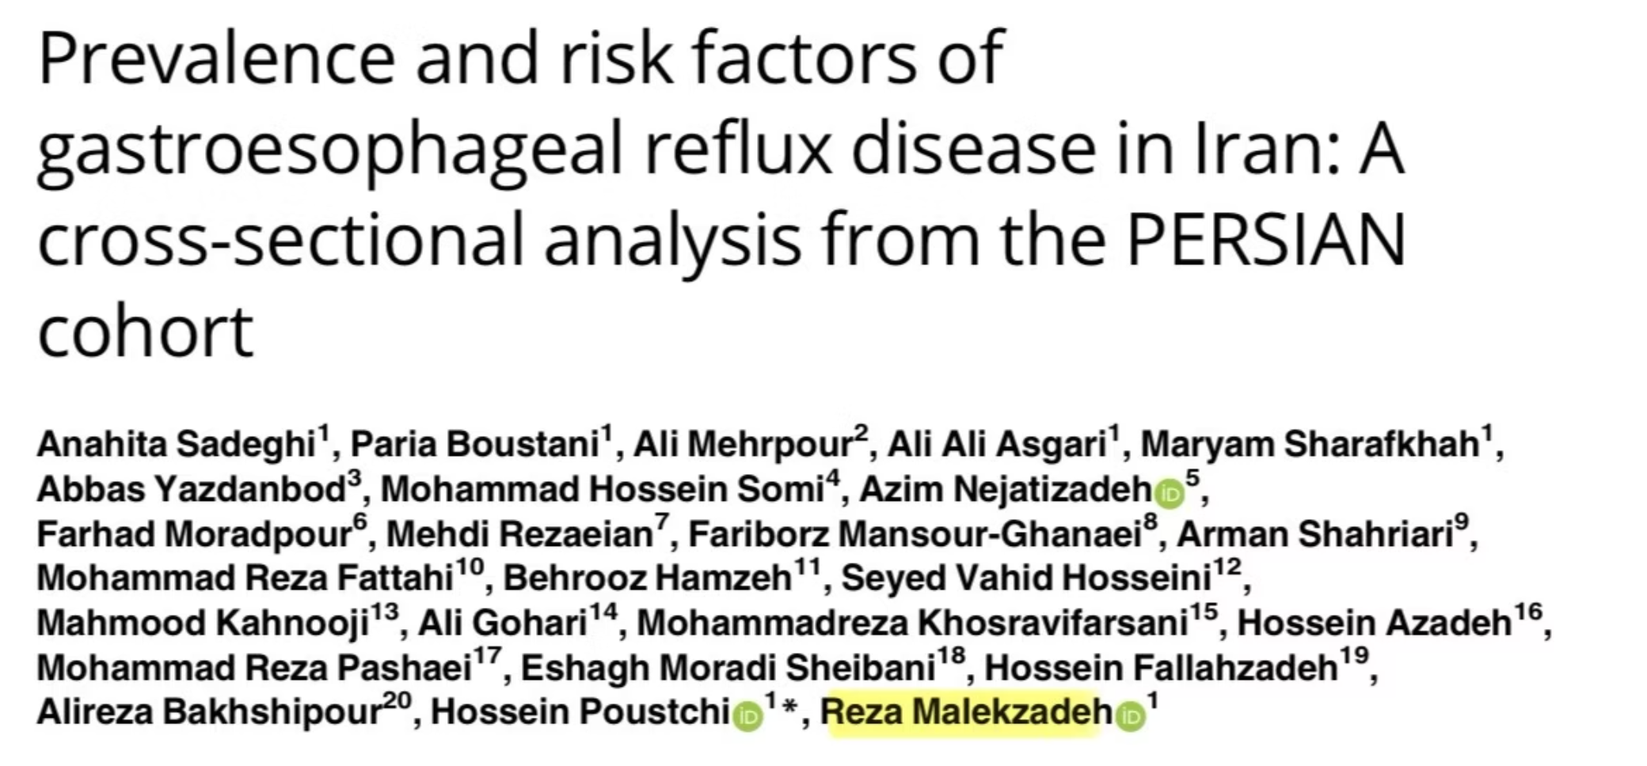
GERD prevalence: 22%
Persian cohort 163018 individuals in 2024
IBS symptoms in up to 50% of GERD patients

Slide 5

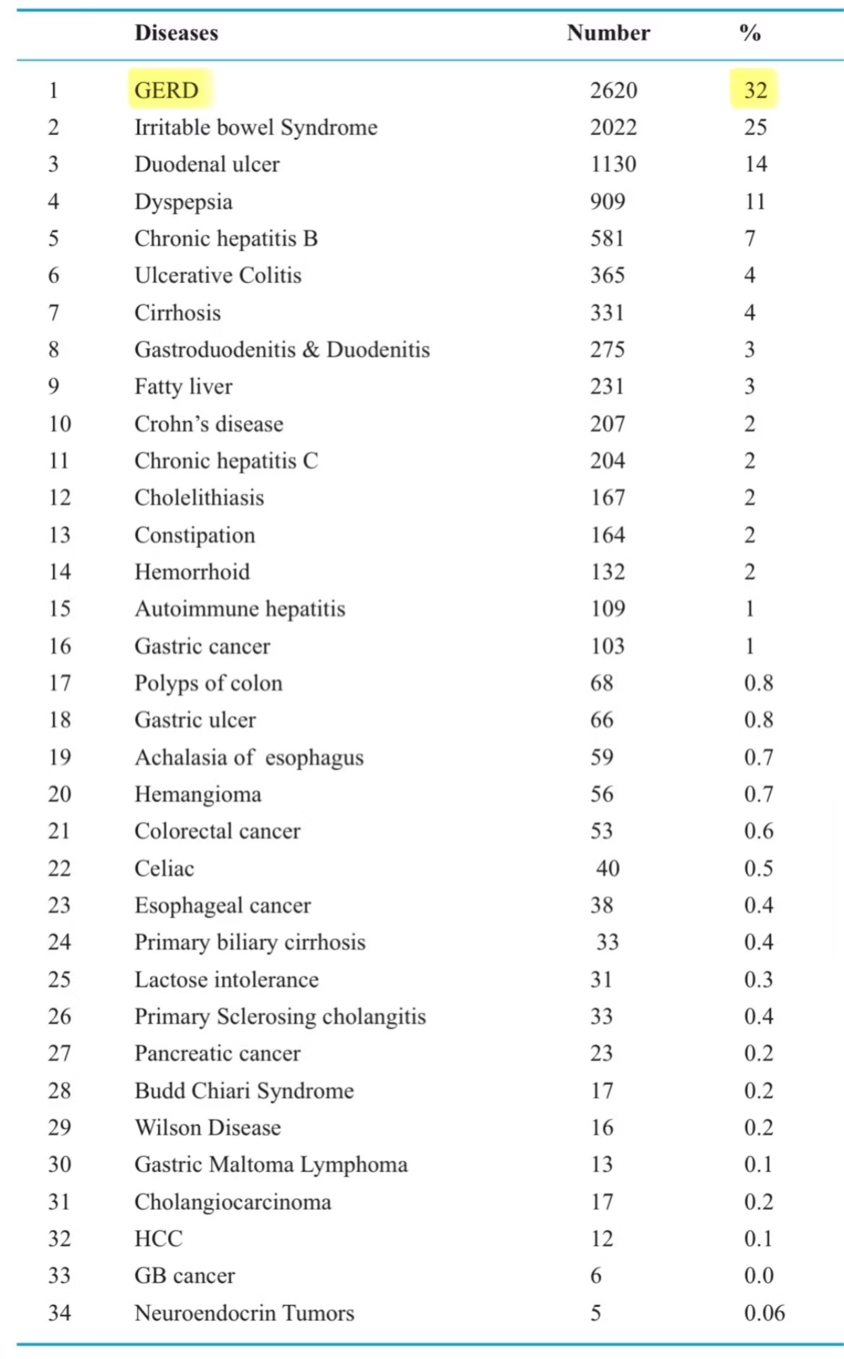
Leading Dx in OPD GI clinics

Slide 6
Why is GERD surging today?
Decline in H.pylori prevalence
Obesity
Diet: UPFs
NSAIDS
Genetic factors
Oral hygiene
Other…

Slide 7

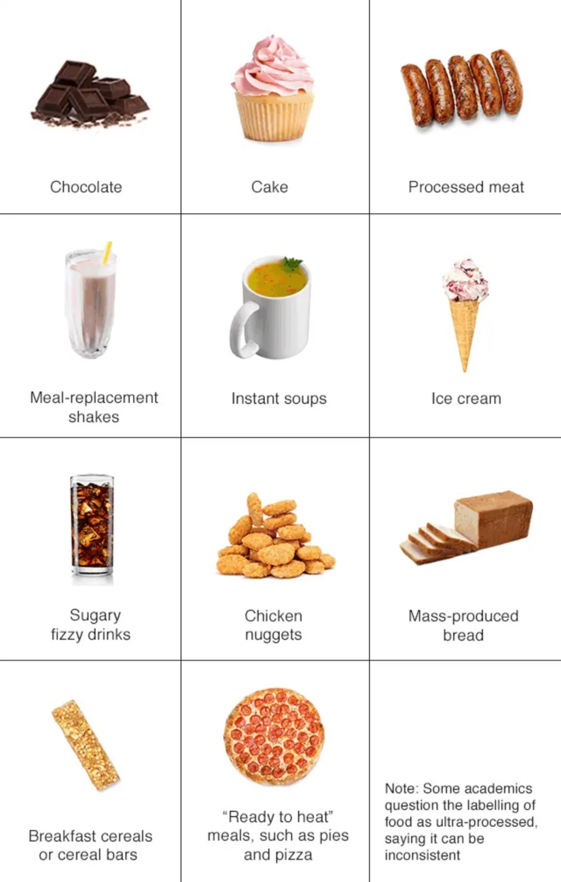
UPFs
sausage/hamburgers
breakfast cereals
instant soups
sugary drinks
chicken nuggets
cake/chocolate/ice cream
ready to heat meals

Slide 8
Symptoms of GERD
Classic symptoms
Alternative esophageal symptoms
Heart burn
Dysphagia/ Odynophagia
Regurgitation
Chest pain
Water brash
Globus sensation
Extra esophageal manifestations
Chronic cough
Asthma
Pharyngitis
Laryngitis
Recurrent otitis
Sinusitis
Halitosis

Slide 9
Red flags
Lab data
Physical Examination
Anemia
History
Fever
Wt loss
Leukocytosis
Bulging fontanelle
High ESR
Anorexia
Microcephaly/Macrocephaly
Onset of vomiting after 6 months of life
Distended abdomen
Forceful vomiting
Hematemesis
Rectal bleeding
Chronic diarrhea
Bilious vomiting
Coughing with feeds
Seizure
GI cancer in first-degree relative
New onset dyspepsia in patients having 60y/o or more

Slide 10
The diagnosis of uncomplicated GER does not require specific testing.

Slide 11
Constipation vs GERD: finding the real culprit
Cologastric brake

Slide 12
PPI test
Empiric treatment for 4-8 wks in older children with uncomplicated heartburn

Slide 13
Avoid using PPI trial as a diagnostic tool in infants
Nonspecific symptoms
High placebo response
Potential risks of PPI
Not diagnostic

Slide 14
Reserve PPI for infants with persistent GERD related symptoms despite conservative measures.
poor wt gain
feeding refusal
marked irritability in a pattern that suggests esophageal pain

Slide 15




When to Consider Diagnostic Testing
Atypical Symptoms
Poor Treatment Response
When symptoms don't match classic GERD presentation
Symptoms persist despite appropriate medication and lifestyle changes
Suspected Complications
Differential Diagnosis
Signs of esophagitis, Barrett's esophagus, or other complications
To rule out other conditions that may mimic GERD symptoms

Slide 16
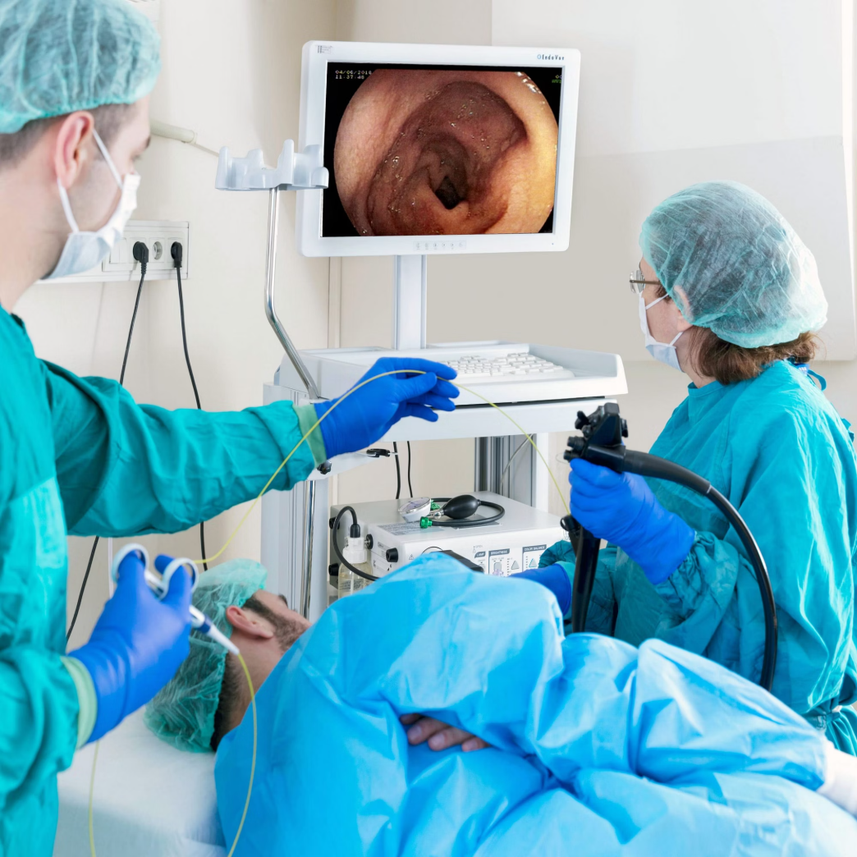
Upper Endoscopy
Indications
Not to use for diagnosis
Dysphagia
Use to asses complications of GERD or prior to escalation of therapy
Odynophagia
Recurrent regurgitation after 2 years of age
Heartburn or epigastric abdominal pain that fails to respond to or relapses quickly after empiric treatment
R/O EOE
Relieve esophageal obstruction

Slide 17

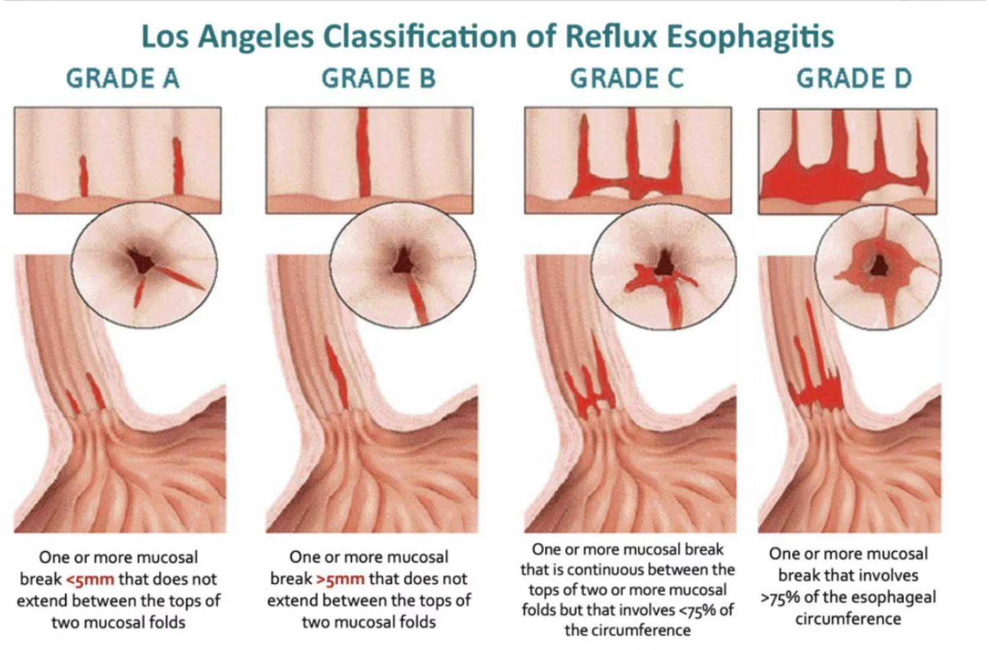
LA grade B/C/D confirms GERD

Slide 18

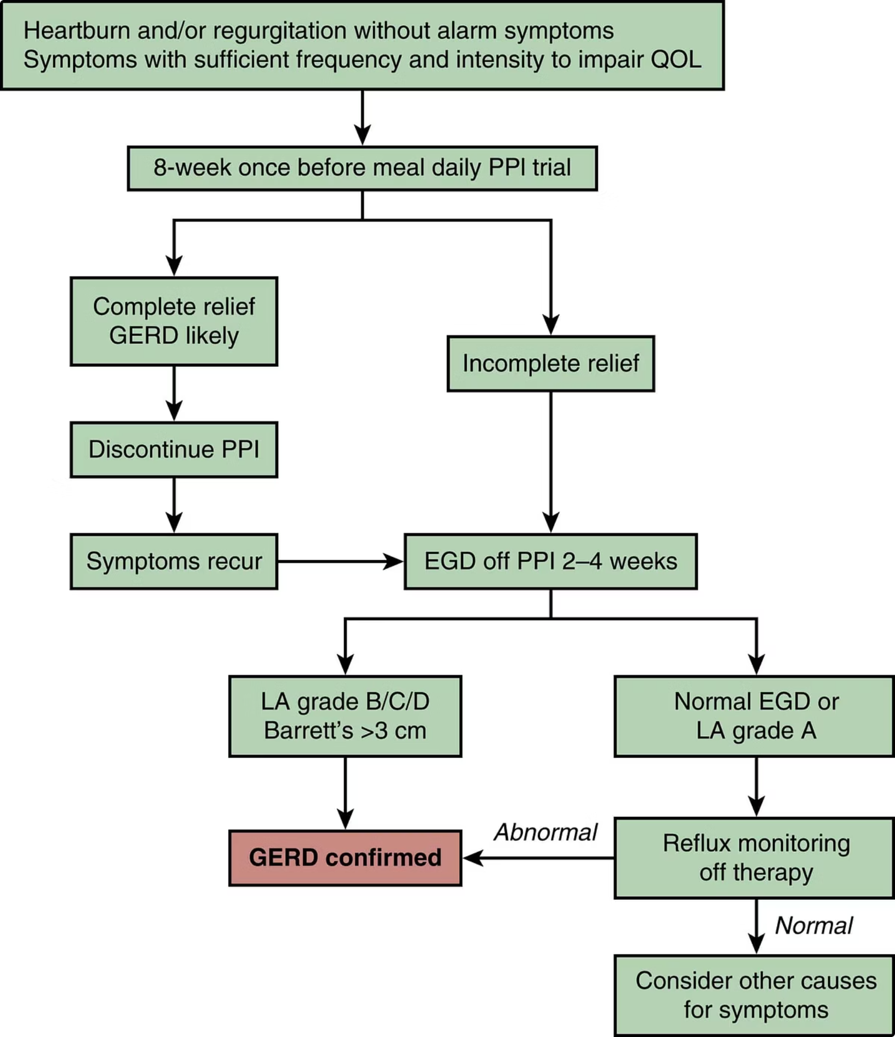
Off PPI 2-4 wks before EGD

Slide 19
Terminology
Erosive esophagitis
Nonerosive reflux disease (NERD)
Reflux hypersensitivity or functional heartburn

Slide 20

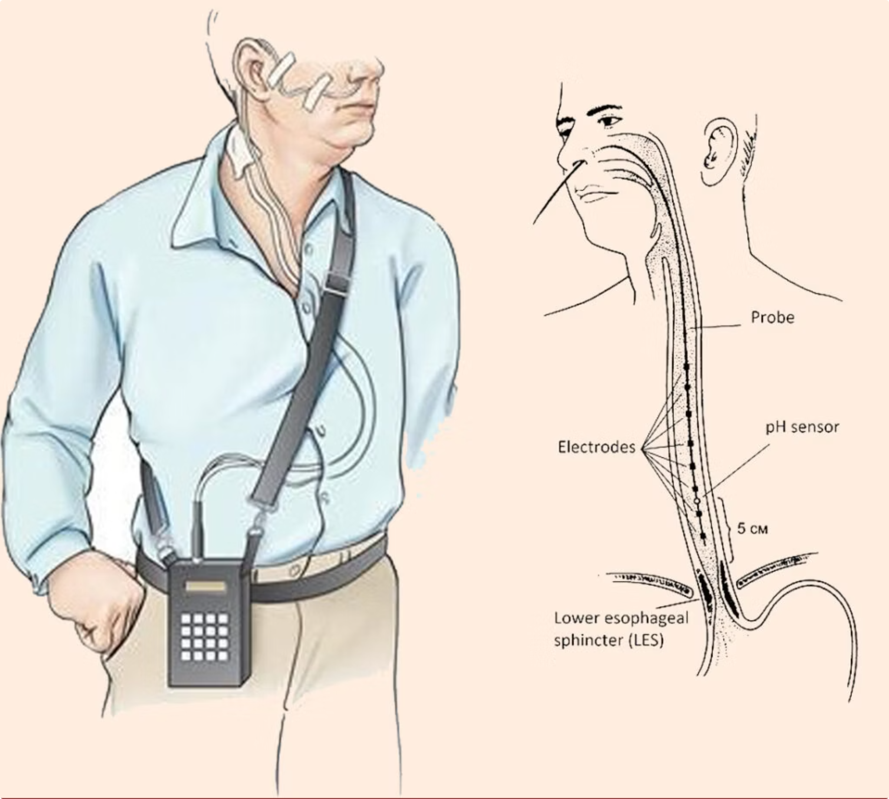


Esophageal pH Monitoring
The gold standard for quantifying acid exposure and correlating symptoms with reflux events.
Catheter-Based Monitoring
A thin tube through the nose into the esophagus records acid levels for 24 hours while the patient maintains normal activities and diet.
Wireless Capsule System
A small sensor attached to the esophageal wall transmits pH data for up to 48-96 hours, improving patient comfort and diagnostic yield.

Slide 21
Indications of PH-metry
Differentiate patients with NERD, hypersensitive esophagus & functional heartburn in patients with normal endoscopy
Evaluating treatment effectiveness
Persistent symptoms despite acid suppression

Slide 22
Ultrasonography
Suggests not to use for Dx of GERD
Use to exclude anatomical abnormalities

Slide 23

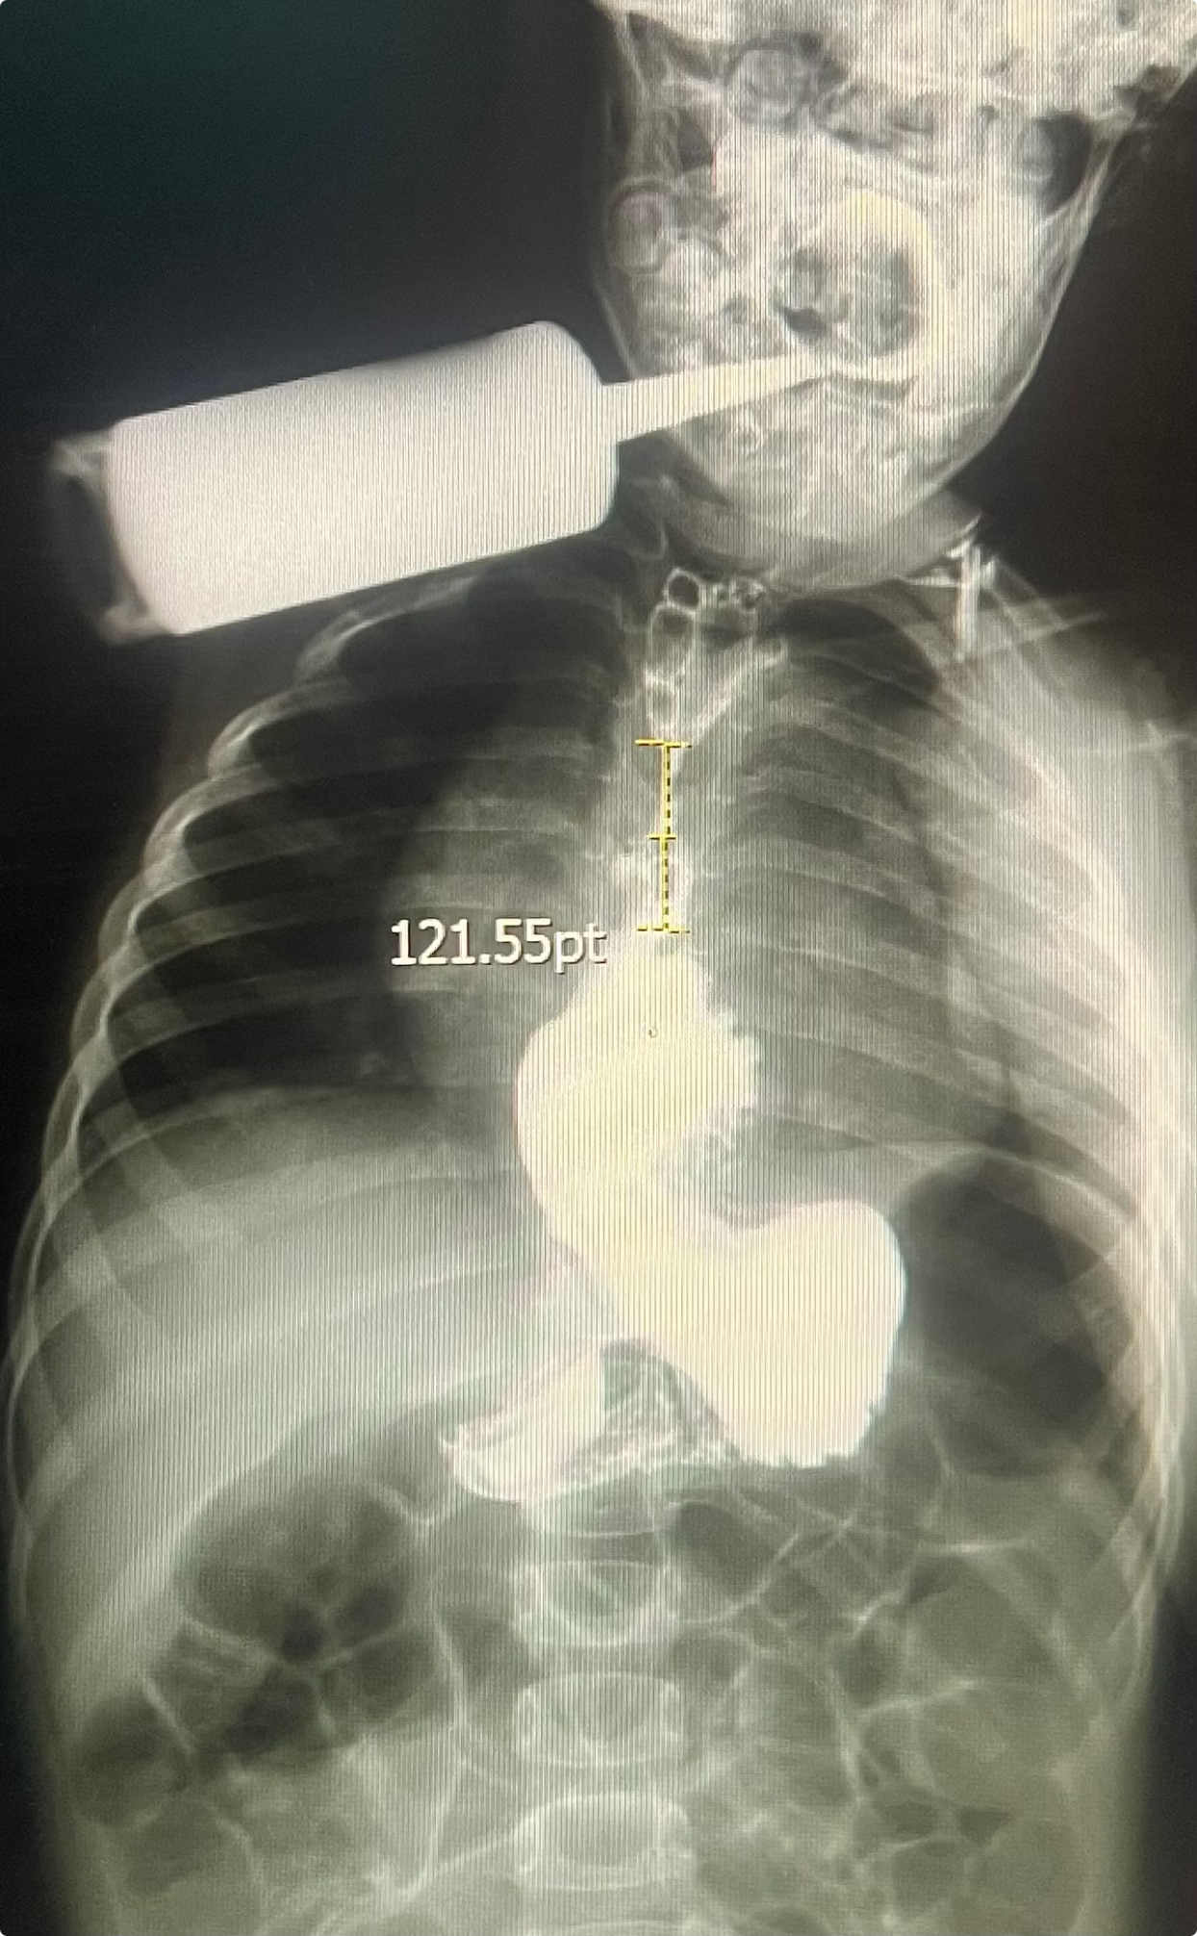
Esophageal Manometry and Imaging
Manometry
Barium Swallow
Evaluates lower esophageal sphincter (LES) function
Visualizes structural abnormalities
Identifies motility disorders that may mimic or exacerbate GERD
Detects hiatal hernias
Identifies strictures or narrowing
Essential before anti-reflux surgery
Assesses esophageal emptying

Slide 24
Diagnostic Tools Summary
Diagnostic Method
Primary Use
When Indicated
Symptom Assessment
Initial diagnosis
All patients
Endoscopy
Visualize tissue damage
Alarm symptoms, age >50, treatment failure
pH Monitoring
Confirm acid reflux
Atypical symptoms, pre-surgery
Manometry
Assess muscle function
Dysphagia, pre-surgery
Barium Studies
Structural evaluation
Suspected anatomical abnormalities

Slide 25
Take home message
Refer infants & children with GERD to pediatric GI man if:
Alarm signs or symptoms
Refractory to treatment
Can not permanently weaned from pharmacological treatment

Slide 26
Thank U for your attention

