Slide 1
Bronchiolitis
DR. Mohammad Ashkan Moslehi
Director of Pediatric Pulmonology Division
Shiraz University of Medical Sciences

Slide 2
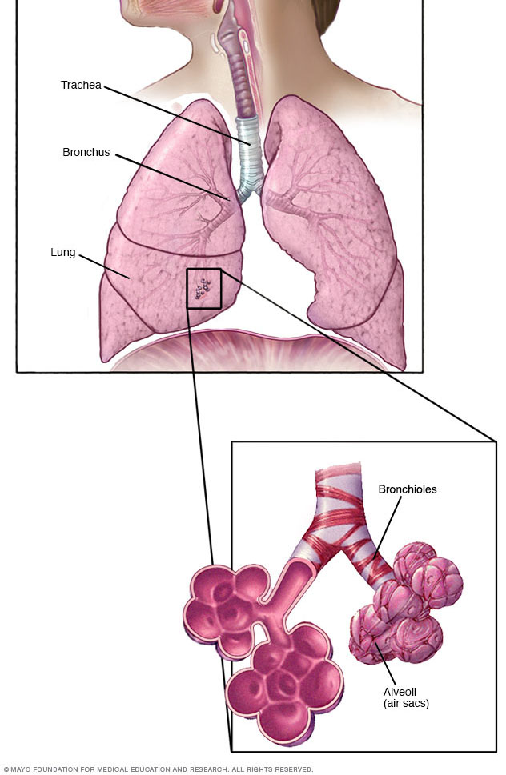

Slide 3
diagnostic term> viral lower respiratory tract infections in infants and very young children.
Tachypnea, wheezing, crackles, and rhonchi
No diagnostic criteria

Slide 4
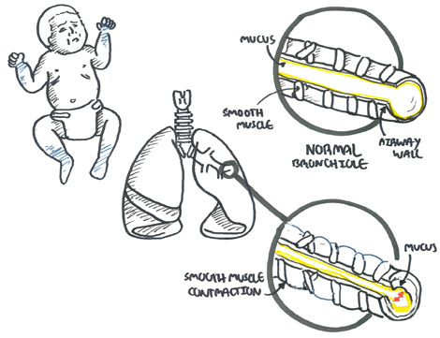
The pathophysiology of acute bronchiolitis is characterized by
bronchiolar obstruction with edema, mucus, and cellular debris

Slide 5
Resistance in the small air passages is increased during both
inspiration and exhalation
the radius of an airway is smaller during expiration
leads to expiratory wheezing, air trapping, and lung hyperinflation
If obstruction becomes complete, trapped distal air will be resorbed and the child will develop atelectasis & hypercapnia (sever Type)
Hypoxemia is a consequence of ventilation-perfusion mismatch.
RSV>50%
coinfection

Slide 6
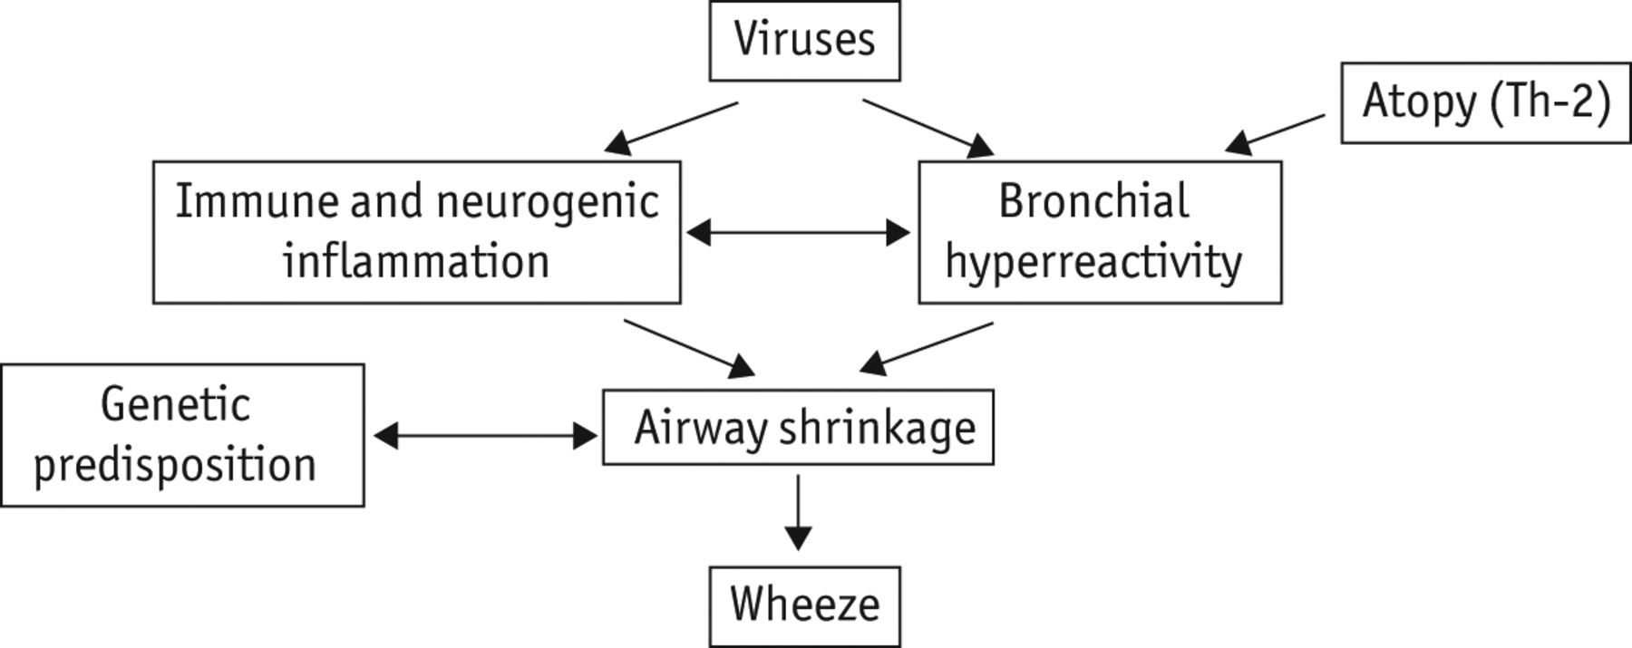

Slide 7
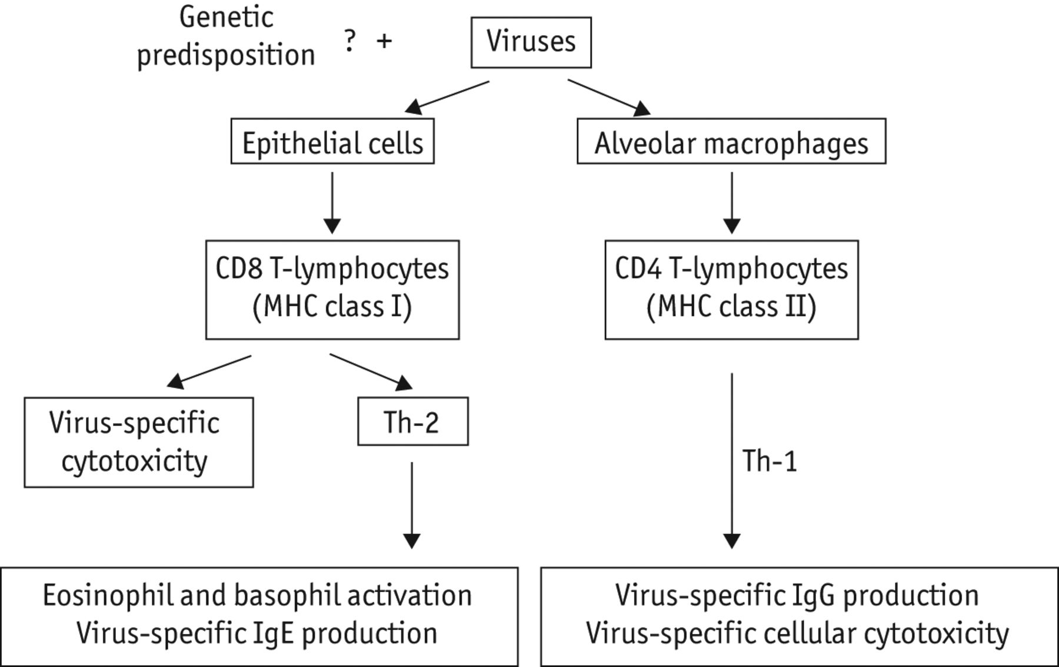

Slide 8
viral bronchiolitis is rarely followed by bacterial superinfection.

Slide 9
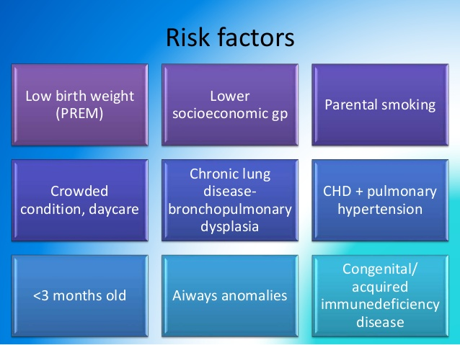
Not been breastfed
Male

Slide 10
Hx: exposure to contacts with a minor respiratory illness within the previous week
sneezing and clear rhinorrhea
Diminished appetite and fever
Respiratory distress ensues, with paroxysmal cough, dyspnea, and irritability
Apnea may precede lower respiratory signs early in the disease, particularly with very young infants.
Term infants at a postconceptual age of <44 wk and preterm infants at postconceptual age <48 wk are at highest risk for apneic events.

Slide 11
physical examination
Expiratory wheezing and crackles.
Expiratory time may be prolonged.
Work of breathing may be markedly increased, with nasal flaring and retractions.
Poorly audible breath sounds suggest severe disease with nearly complete bronchiolar obstruction.

Slide 12
Diagnostic Evaluation
The diagnosis is clinical, particularly in a previously healthy infant presenting with a first episode of wheeze
Chest radiography is not routinely indicated (may encourage unnecessary antibiotic use)
Areas of atelectasis associated with bronchiolitis are often observed
Laboratory testing is also not routinely indicated
Viral testing is also not routinely indicated
Concurrent serious bacterial infection (sepsis, pneumonia, meningitis) is unlikely

Slide 13
Diagnostic Evaluation
confirmation of viral bronchiolitis may obviate the need for a sepsis evaluation in the young febrile infant.
Otitis media may complicate bronchiolitis.
Children with recurrent or refractory episodes of wheezing in infancy, particularly if associated with failure to thrive, may require evaluation for chronic disorders such as cystic fibrosis or immunodeficiency.

Slide 14
Treatment
Supportive
Respiratory distress (hypoxia, inability to feed, apnea, extreme tachypnea) or having Risk Factors should be hospitalized
Hypoxemic children should receive supplemental oxygen >90%
High-flow nasal cannula is a noninvasive mode of oxygen delivery capable of providing some positive end expiratory pressure
Hydration
care should be taken to use isotonic fluids due to risk of hyponatremia

Slide 15
Treatment
Frequent suctioning of nasal and oral secretions often provides relief of distress and improves work of breathing and ability to feed,
Suctioning should be limited to the nares or oropharynx because deep tracheal suctioning does not provide additional benefit.
Chest physiotherapy provides no benefit to children with bronchiolitis
Pharmacologic agents have largely proven ineffective (B agonist and ICS)
There is debate over the use of hypertonic saline(most studies and meta-analyses fail to demonstrate any benefit)

Slide 16
Treatment
Epinephrine has not been found to improve length of stay or clinical outcomes among inpatients with bronchiolitis, some evidence to suggest that it may reduce risk of hospitalization when used in the outpatient setting.
Ribavirin not currently recommended

Slide 17
PROGNOSIS
Are at highest risk for further respiratory compromise in the first 72 hours after onset of cough and dyspnea.
case fatality rate is <1%
Median duration of symptoms is approximately 14 days
10% may be symptomatic for 3 wk
a possible risk factor for the development of asthma

Slide 18
PREVENTION
Hand hygiene is the best measure to prevent transmission
For high-risk populations, palivizumab, an intramuscular monoclonal antibody to the RSV F protein, may be given as a prophylactic agent
Reduce risk of hospitalization
It has not been shown to decrease mortality and does not protect against bronchiolitis caused by other viruses and is also quite costly
<29-wk completed gestation or those with significant heart disease or chronic lung disease of prematurity + neuromuscular disease and immunocompromised states

Slide 19
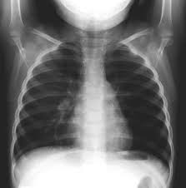



Slide 20
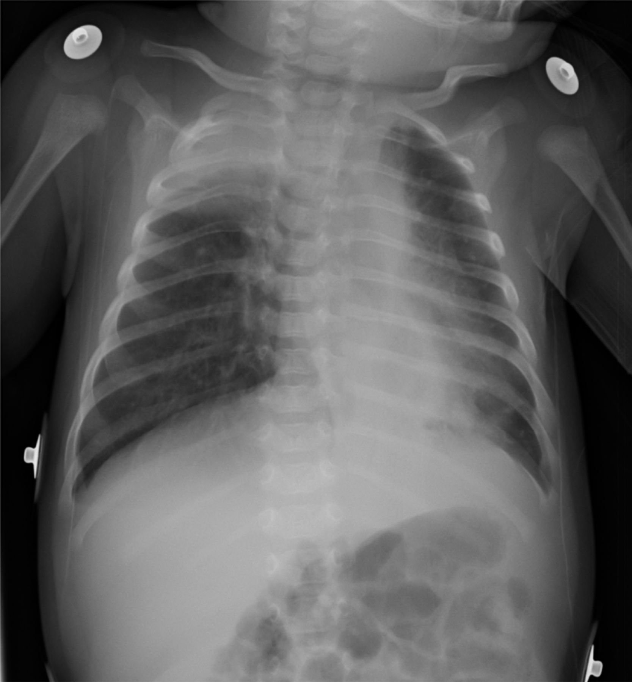


Slide 21


