Slide 1
Preseptal & orbital cellulitis
S.S. Hamzavi MD Subspecialty in pediatric infectious diseases
Shiraz University of Medical Sciences

Slide 2
PRESEPTAL(PERIORBITAL) & ORBITAL CELLULITIS
Anatomy
Terminology
Pathogenesis
Microbiology
Clinical manifestation
Differential diagnosis
Diagnosis
Treatment

Slide 3
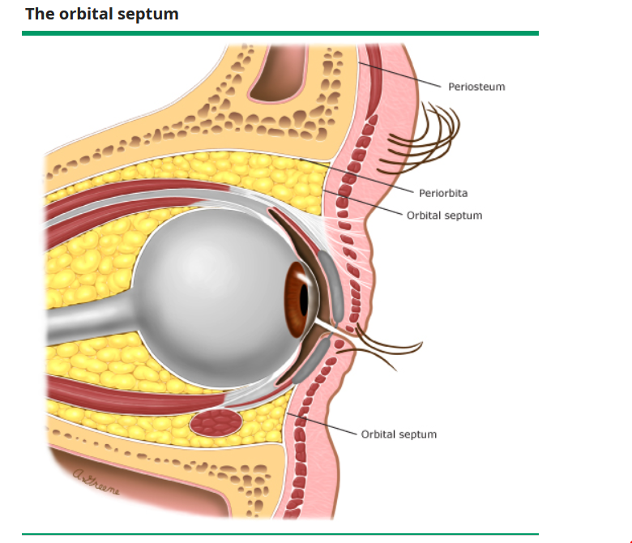
ANATOMY
The orbital septum is a thin layer of fascia that
extends vertically from the periosteum of orbital
rim to the tarsal plate within the eyelids (feigin)
The septum provides a barrier that slows
the spread of infections agents into deeper
Orbital and retro orbital structure

Slide 4
TERMINOLOGY
Preseptal cellulitis and orbital cellulitis involve different anatomic site
preseptal cellulitis : Inflammation of the lids and periorbital tissue
(anterior to the orbital septum)
This is a common entitiy in young children ( usually under age 5 yr )
orbital cellulitis : an infection involving the contents of the orbit
(fat and ocular muscles) but not the globe.
The mean age is 6.8 yr , ranges from 1 wk to 16 yr

Slide 5
PATHOGENESIS
Preseptal
- Posttraumatic (puncture wound
on the lids, face, scalp , bite , blunt trauma )
- Nontraumatic :
acute dacryocystitis, sinusitis or upper respiratory tract infection,
Bacteremic seeding of the preseptal space is rare
Orbital
Sinusitis (ethmoid )
Penetrating orbital trauma
Skin infection
Dental infection
Orbital , ocular ,periocular surgery
Bacteremia
Infection of lacrimal gland
Nasolacrimal sac,…

Slide 6
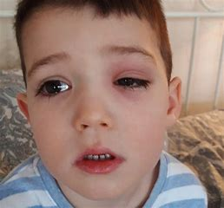
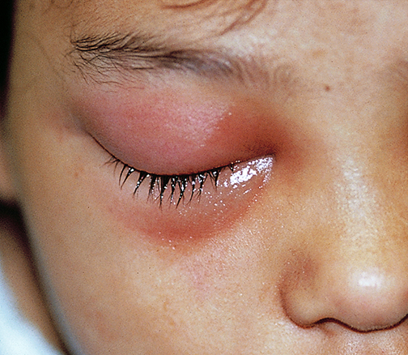
PRESEPTAL CELLULITIS SIGNS & SYMPTOMS
Involved lid :Edematous , erythematous , tender(unilateral)
Fluctuation of subcutaneous tissue
Swelling of uninvolved eyelids (lymphedema)

Slide 7
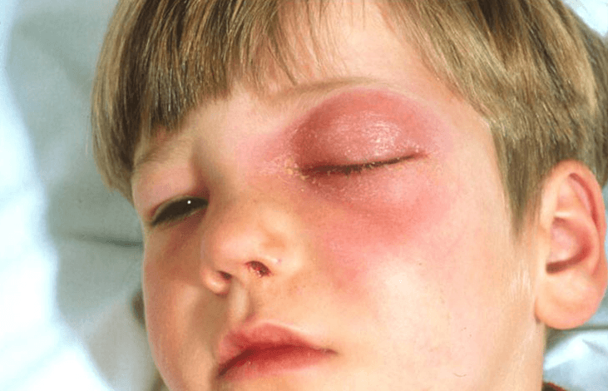
ORBITAL CELLULITIS(SIGNS & SYMPTOMS)
Proptosis
Limited eye movement(total ophthalmoplegia)
Abnormal pupillary response
Chemosis
Fever (39 -40)

Slide 8
CLINICAL MANIFESTATION

Slide 9
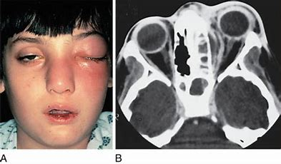
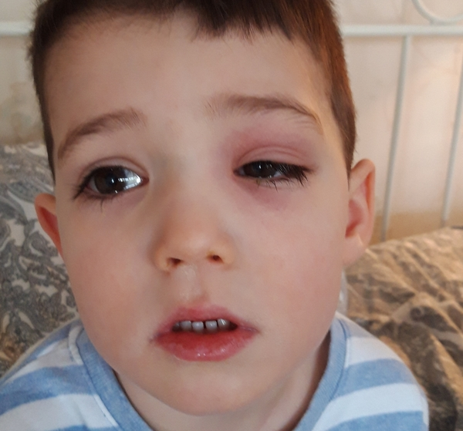
PRESEPTAL & ORBITAL CELLULITIS

Slide 10
ADENOVIRUS INFECTION
Copious discharge (may be serous)
Swelling of the lids (minimal erythema)
Preauricular lymphadenopathy
Conjunctival hyperemia with or without chemosis
Subconjunctival hemorrhage
Photophobia (punctate keratopathy)
History of recent contact

Slide 11
MICROBIOLOGY PRESEPTAL CELLULITIS
Post traumatic :
s.aureus
s.pyogenes
anaerobes ( peptococus ,
peptostreptococcus, bacteroides)
p.multocida ( after cat and dog bite )
Nontraumatic :
strep . pneumoniae
H.influenza type b
adenovirus

Slide 12
MICROBIOLOGY ORBITAL CELLULITIS
Staphylococcus aureus and streptococci ( most common )
Haemophilus influenzae type b , Nontypeable H. influenzae
combination of aerobic and anaerobic bacteria
anaerobes , such as Eikenella corrodens , Fusobacterium , and Peptostreptococcus (rare )
gram-negative bacilli, such as Pseudomonas aeruginosa, Klebsiella (rare)
fungi, especially Mucorales (which causes mucormycosis) and Aspergillus spp.

Slide 13
DIFFERENTIAL DIAGNOSIS (PRESEPTAL)
Local allergic reaction
Angioedema
hordeolum
Chalazion

Slide 14
DIFFERENTIAL DIAGNOSIS (ORBITAL)
Blunt trauma
Wegener
Sarcoidosis
Leukemic infiltration
Lymphoma
Rhabdomyosarcoma
Retinoblastoma
Metastatic carcinoma
Histiocytosis X

Slide 15
DIAGNOSIS PRESEPTAL CELLULITIS
Preseptal cellulitis is usually a clinical diagnosis
Laboratory testing is generally unnecessary for patients with preseptal cellulitis.
Blood culture is more likely to be positive in children younger than 2 years.
Gram stain and culture ( aerobic & anaerobic ) of any mucopurulent material (feigin)

Slide 16
IMAGING PRESEPTAL
CT imaging :
marked eyelid swelling, fever, and leukocytosis,
infection fails to show improvement after 24 to 48 hours of
appropriate antibiotics.
Imaging findings of preseptal cellulitis demonstrate swelling of the eyelid(s) but no proptosis, no fat stranding of the orbital contents, and no edema of the extraocular muscles

Slide 17
ADMISSION PRESEPTAL CELLULITIS
Younger than 1 year
Signs of systemic toxicity
Inadequate H. influenza immunization

Slide 18
DIAGNOSIS ORBITAL CELLULITIS
Hospitalization
CT imaging with IV contrast ( orbit , paranasal sinuses )
Brain imaging
Lumbar puncture ( in infants and those with signs of CNS infection )
Exam for signs of visual deterioration or pupillary abnormalities
(daily )

Slide 19
TREATMENT PRESEPTAL CELLULITIS
Posttraumatic :
dog or cat bite : amoxicillin – clavulanate
well appearing with infected wound or bite : oral antibiotics (GAS , S.aures )
ill appearing : ampicillin –sulbactam or clindamycin plus cefotaxime or
ceftriaxone

Slide 20
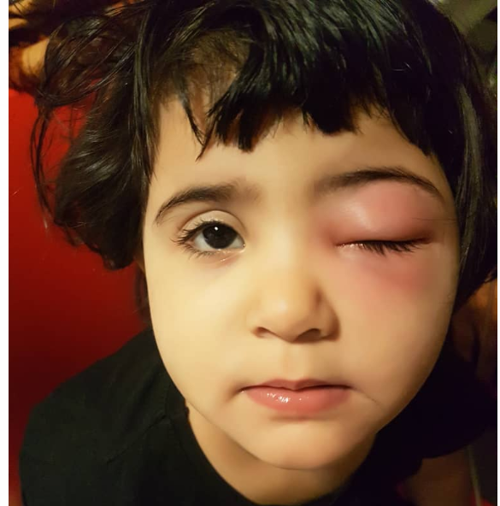
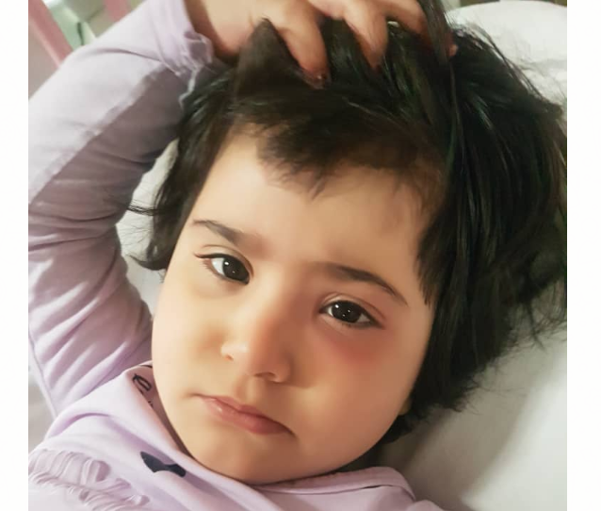
Preseptal cellulitis

Slide 21
TREATMENT ORBITAL CELLULITIS
Parenteral antibiotics ( ampicillin sulbactam or clindamycin plus ceftriaxone
Intracranial extension : vancomycin plus cefotaxime plus metronidazole
Drainage
Sinusitis ( nasal decongestant , drainage of the infected sinus )
Vision should be assessed daily

Slide 22
Indications for consideration of surgical drainage
Age ≥ 9 years
Presence of frontal sinusitis
Nonmedial location of orbital abscess (≥1250mm)
Suspicion of anaerobic orbital infection
a : presence of gas within the abscess space
b : infection of dental infection
Recurrence of abscess after prior drainage
fail to respond promptly to antibiotic treatment,
threaten vision
Medial subperiosteal abscesses in children often respond to medical therapy without surgery

Slide 23
SURGICAL BIOPSY
For patients with a poor response to antibiotic treatment, including worsening visual acuity or pupillary changes,
To identify pathogens not treated by the empiric regimen (eg, fungal pathogens) and to rule out noninfectious causes of orbital inflammation

Slide 24
DURATION OF TREATMENT
preseptal
orbital
Systemic antibiotics for 7 to 10 days
Switch to an oral antiobiotic :
afebrile for at least 24 hours
and clinically improvment
Uncomplicated :
10-14 days in hospital
7-10 days oral antibiotics

Slide 25
COMPLICATIONS OF ORBITAL CELLULITIS
Visual loss (increase in orbital pressure )
Cavernous sinus thrombosis
Meningitis
Epidural or subdural abcesse

Slide 26
RECURRENT PRESEPTAL CELLULITIS
Preseptal cellitluis rarely recurs.
it is usually due to an underlying cause that has not been diagnosed (sinusitis)

Slide 27
FUNGAL ORBITAL CELLULITIS
Immunocompromised , metabolic acidosis, poorly diabetes
Subacute , chronic
Orbital apex syndrome ( loss of function of 2,3,4,5,6 cranial nereves
Black eschar-like lesion ( in the oropharynx or nasopharynx
Biopsy is required

Slide 29
